Slide 2
Components of MVC
🔹 Model
Definition: Represents the data of the application.
Responsibilities:
  Manages application state and data.
  Notifies the View when data changes.
Example: In an e-commerce app, Product, Cart, and Order classes form the model.

Slide 3
2. Components of MVC
🔹 View
Definition: The presentation layer responsible for rendering data to the user.
Responsibilities:
  Displays information to the user (UI elements, templates).
  Updates when the Model changes.
  Should not contain business logic.
Example: HTML/CSS page showing products and cart items.

Slide 4
2. Components of MVC
🔹 Controller
Definition: The mediator that handles user input and updates the Model or View accordingly.
Responsibilities:
  Interprets user actions (clicks, inputs, gestures).
  Updates the Model state based on user input.
  Chooses the View to render.
Example: In Spring MVC, a controller method handles HTTP requests, updates the model, and returns a view.

Slide 5
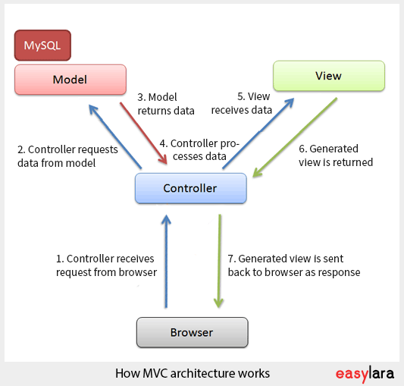
🔄 Interactions of M V C
Flow:
  User interacts with View.
  Controller interprets input, updates Model.
  Model changes → notifies View.
  View re-renders updated data.

Slide 6
Understanding MVC
Model is the kitchen—it holds the "data" (like ingredients, recipes, and stock). It doesn't care how the food is served; it just manages what's available and updates if something changes (e.g., "out of pizza dough").
View is the menu and your table—it shows the pretty presentation (what the user sees, like "Pizza: $10"). It doesn't cook or decide; it just displays and takes your order input.
Controller is the waiter—they take your order from the table (View), yell it to the kitchen (Model) to prepare/update, and bring back the result to show you (e.g., "Your pizza is ready!").

Slide 7
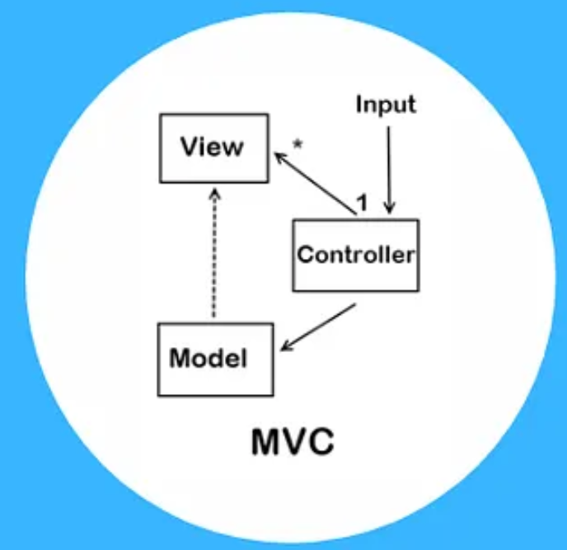
Understanding MVC
The flow:
User picks from View →
Controller handles it →
Model updates data →
View refreshes to show changes.
Real-World Example: In a weather app, Model fetches real rain data, View shows a sunny icon, Controller decides when to update the icon based on user location clicks.

Slide 8
Understanding MVP(Model-View-Presenter)
Like MVC, but the Presenter is a super-smart waiter (or manager) who does everything for the View—making the View "dumb" (it just shows stuff and says "Hey, user clicked this!").
Model: Still the kitchen (data and rules).
View: Now just the menu/table—it reports user actions to the Presenter but doesn't talk to the Model at all.
Presenter: Takes input from View, talks to Model, formats the response perfectly, and tells the View exactly what to show (no direct Model-View chit-chat).

Slide 9
Flow:
  User interacts with View →
  View tells Presenter →
  Presenter updates Model and pushes results back to View.
  Great for testing, since the Presenter can be mocked without a real screen.
Real-World Example: In a login app, View shows username/password fields, Presenter checks credentials via Model (database), and directly tells View "Show success page" or "Show error popup."

Slide 10
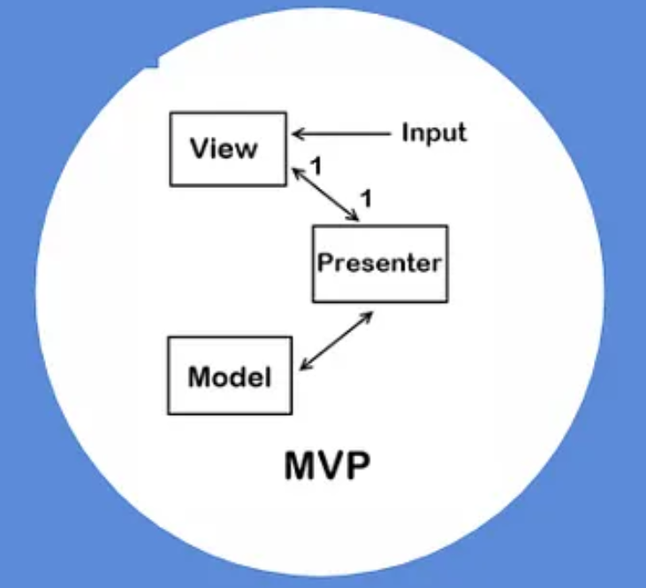

Slide 11
Understanding MVVM (Model-View-ViewModel)
This is for "smart" apps with automatic updates, like a magic restaurant where the menu auto-refreshes.
Model: Kitchen again (raw data).
View: Menu/table—binds directly to ViewModel for auto-updates (e.g., if stock drops, it shows "Low stock!" without asking).
ViewModel: A "translator" layer—it takes Model data, makes it View-friendly (e.g., formats prices), and exposes it via "bindings" so changes auto-sync. No direct Controller; the ViewModel handles commands from the View.

Slide 12
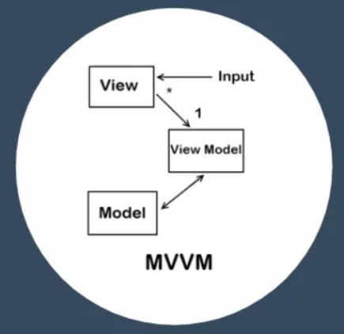
Flow:
View binds to ViewModel →
User acts on View →
ViewModel updates Model and auto-refreshes View via bindings.
Perfect for apps where data changes fast (like live stock tickers).
Real-World Example:
In a shopping cart app, View shows item list bound to ViewModel, which pulls from Model (cart data).
Add an item? ViewModel updates, and View auto-shows the new total—no manual refresh!

Slide 13
3. Comparison with Traditional Monolithic Architecture
🔹 Monolithic Applications
UI, business logic, and data handling are tightly coupled in one block.
Problems:
  Difficult to maintain.
  Hard to scale parts independently.
  Poor separation of concerns.
  Testing and debugging are harder.

Slide 14
3. Comparison with Traditional Monolithic Architecture
🔹 MVC Advantages
Separation of Concerns → Easier to maintain and extend.
Parallel Development → Different teams can work on Model, View, and Controller separately.
Reusability → Views can be reused with different Models.
Testability → Business logic (Model) can be tested without worrying about UI.
Flexibility → Easier to swap Views or Controllers without affecting the core logic.

Slide 15
5. MVC vs. MVP (Model-View-Presenter)
Aspect | MVC | MVP
Origin | Oldest (1979, Smalltalk) | Evolved later (used in WinForms, Android, etc.)
View’s Role | Passive → waits for Model updates | Active → interacts with Presenter directly
Controller / Presenter | Controller interprets input, updates Model | Presenter takes full control of View updates
Dependency | View depends on Model | View depends on Presenter
Usage | Web frameworks (Spring MVC, ASP.NET MVC) | Desktop & mobile apps (WinForms, early Android)

Slide 16

Maven is a
  build tool (compiles source to JAR/WAR),
  dependency manager (auto-downloads libraries/transitives),
  project manager (POM for metadata like versions/developers), and
  standardizer (uniform structure/lifecycle).
Primarily command-line, but IDE-integrated (Eclipse/NetBeans).

Slide 17
Build Tools Benefits:
Automates repeatable builds (compile, test, Javadoc, deploy).
IDE-agnostic;
Dependency Management:
Pulls from remote repos (e.g., Maven Central) via POM coordinates.
Handles transitives (e.g., Spring's deps) and scopes (e.g., test-only).
Project Management:
POM lists versions, developers, generates changelogs/docs/reports.
Standardization:
Convention over configuration: Fixed directory layout (e.g., src/main/java).
Lifecycle phases: Compile → Test → Package → Deploy.

Slide 18
Maven Installation
Download binary ZIP from maven.apache.org (3.2.5: 7.7MB).
Extract to e.g., C:\Software\apache-maven-3.2.5.
Add bin/ to PATH (System Properties → Environment Variables → Path).
Verify: mvn -version (shows Maven home, Java version).
https://www.geeksforgeeks.org/installation-guide/how-to-install-apache-maven-on-windows/

Slide 19
IntelliJ IDEA Installation
Download IntelliJ IDEA Community/Ultimate (2024.2.4) ZIP/TGZ from jetbrains.com/idea/download.
Extract/rename to ideaIC-2024.2.4; run bin/idea64.exe (Windows) or bin/idea.sh (Unix).
Set up: Choose theme/plugins; create project dir (e.g., ~/idea-workspace).
Maven bundled; enable:
  File → Settings → Build → Build Tools → Maven → Importing → "Import Maven projects automatically".
Verify: New Project → Maven → Quickstart Archetype → Generate.

Slide 20
Standard Directory Structure
Maven conventions (from maven.apache.org):
Directory | Purpose
src/main/java | Main sources.
src/main/resources | Config/resources (e.g., properties).
src/main/webapp | Web files (JSP/HTML/CSS/JS).
src/test/java | Test sources.
src/test/resources | Test resources.
target | Build output (auto-generated).
LICENSE.txt, README.txt | Metadata.

Slide 21
Useful Maven Commands
Compile:
mvn compile
Run tests:
mvn test
Package into JAR:
mvn package
→ Creates target/more-maven-examples-1.0.jar
Run the JAR:
java -cp target/more-maven-examples-1.0.jar com.atuluttam.maven.App

Slide 22
Maven Lifecycle
In Maven, a build lifecycle is a sequence of phases that define the steps to build and deploy a project.
Each phase consists of goals that perform tasks like compiling code, running tests, packaging, and deployment.
👉 A lifecycle is just an ordered set of build phases.
👉 When you run a phase, Maven executes all previous phases in order before it.

Slide 23
Types of Maven Build Lifecycles
Maven defines 3 standard lifecycles:
default – handles project deployment
(compile → test → package → install → deploy).
clean – handles project cleaning
(delete compiled files, artifacts).
site – handles project documentation
(generates reports, site docs).

Slide 24
🔹 Common Phases in the Default Lifecycle
Here are the main phases you’ll use:
Phase | Description
validate | Validates project structure and configuration.
compile | Compiles the source code.
test | Runs unit tests using a testing framework (JUnit/TestNG).
package | Packages compiled code into a distributable format (JAR/WAR).
verify | Runs checks to verify the package is valid.
install | Installs the package into the local Maven repository (~/.m2/repository).
deploy | Copies the package to a remote repository for sharing with others.

Slide 25
🔹 Clean Lifecycle Phases
Phase | Description
pre-clean | Executes tasks before cleaning.
clean | Removes target/ directory (compiled files & artifacts).
post-clean | Executes tasks after cleaning.

Slide 26
Example Commands
mvn clean # Executes the clean lifecycle (pre-clean, clean, post-clean)
mvn compile # Executes validate + compile phases
mvn test # Executes validate + compile + test
mvn package # Executes validate → compile → test → package
mvn install # Executes all phases up to install
mvn deploy # Executes full lifecycle, ending with deploy
mvn site # Generates site documentation

Slide 27
Apache Tomcat
1. Overview of Tomcat
Apache Tomcat is an open-source Java Servlet Container developed by the Apache Software Foundation.
It implements:
  Java Servlet API
  JavaServer Pages (JSP)
  Java Expression Language (EL)
Often referred to as a lightweight application server (not a full JEE server like WildFly or GlassFish).
👉 Mainly used to deploy and run Java-based web applications (WAR files).

Slide 28
2. Features and Capabilities
Open-source and free.
Lightweight and easy to configure.
Supports Servlets, JSP,etc.
Cross-platform (Windows, Linux, macOS).
SSL (HTTPS) support.
Supports hot deployment (redeploy apps without restarting server).
Provides Tomcat Manager web app for deployment, monitoring, and management.
Can be integrated with Apache HTTP Server.

Slide 29
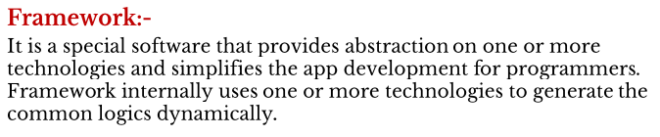

Slide 30
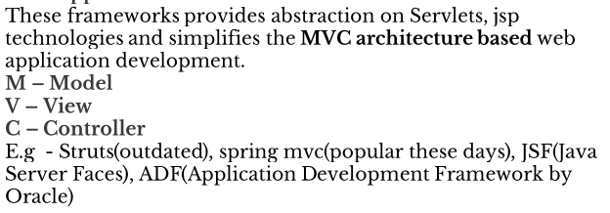
Based on application development we have:
i) Web application Frameworks

Slide 31
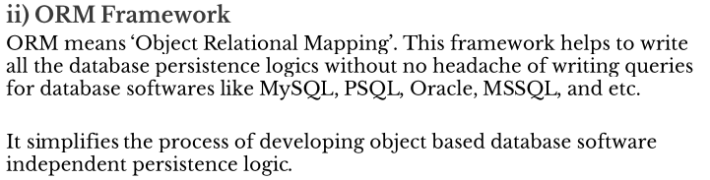
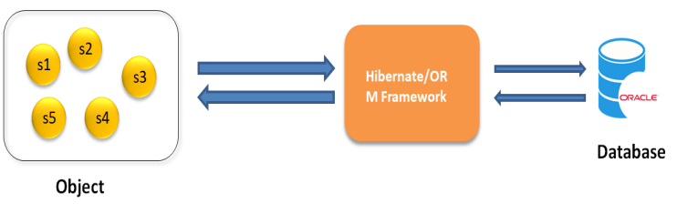

Slide 32
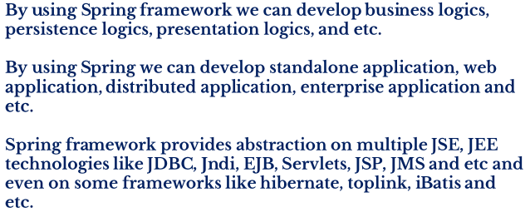
Spring Framework

Slide 33
Spring MVC
A spring MVC is a sub framework of Spring Framework.
Used to build web application.
It is built on top of the servlet API
It follows MVC design pattern.
It implements all the basic features of core spring framework
  Inversion of control, Dependency Injection, etc..

Slide 34
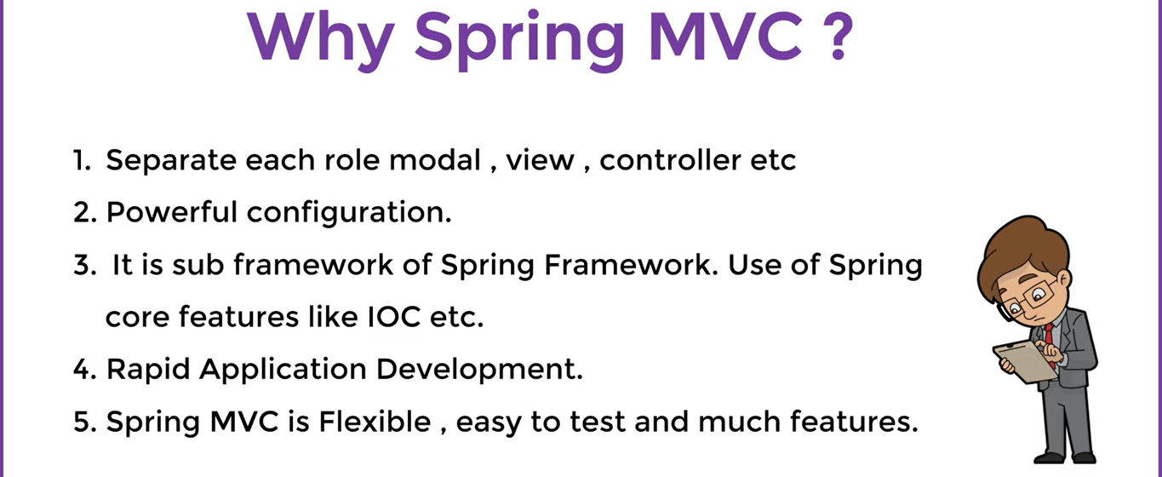

Slide 35
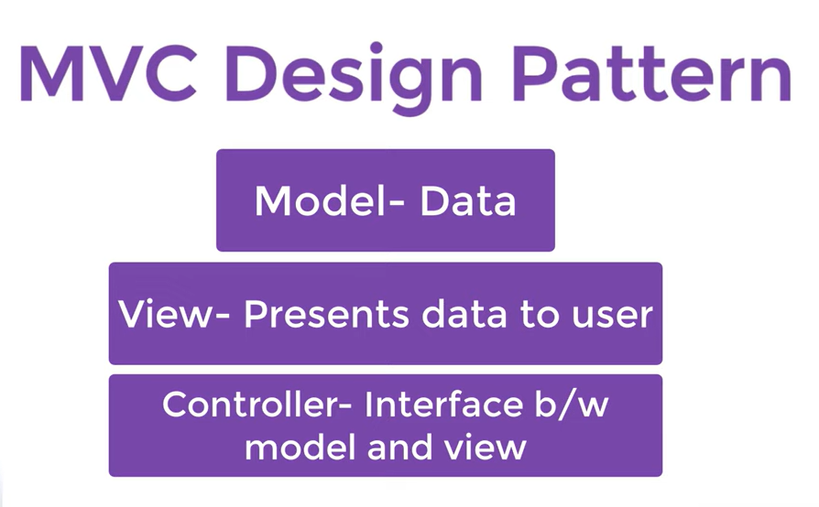

Slide 36
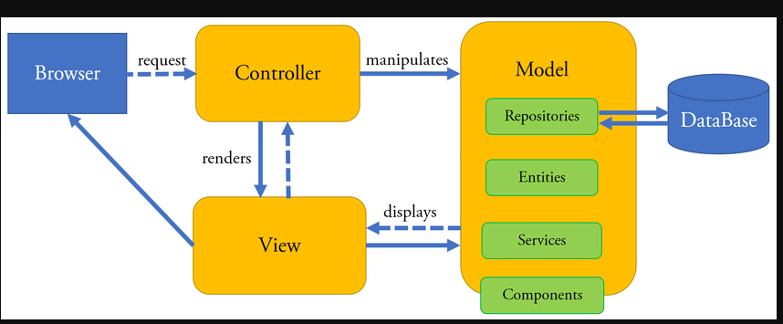

Slide 37
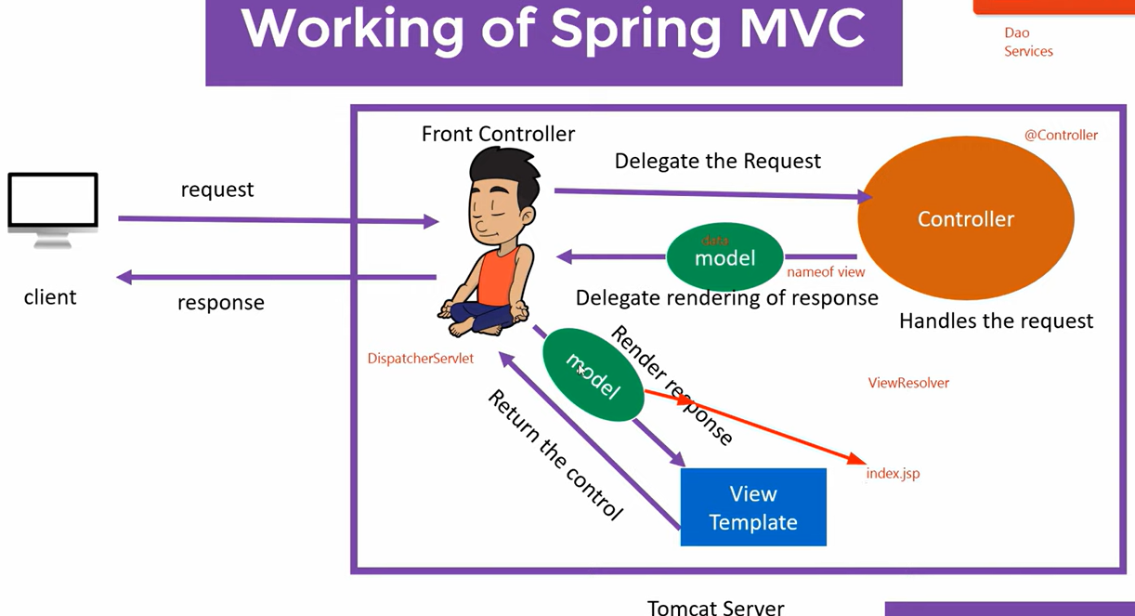

Slide 38
@SpringBootApplication: This annotation is a convenience annotation that includes @Configuration, @EnableAutoConfiguration, and @ComponentScan. It marks the main class of a Spring Boot application.

Slide 43
Hello World !!! In Spring Boot
Using STS

Slide 44
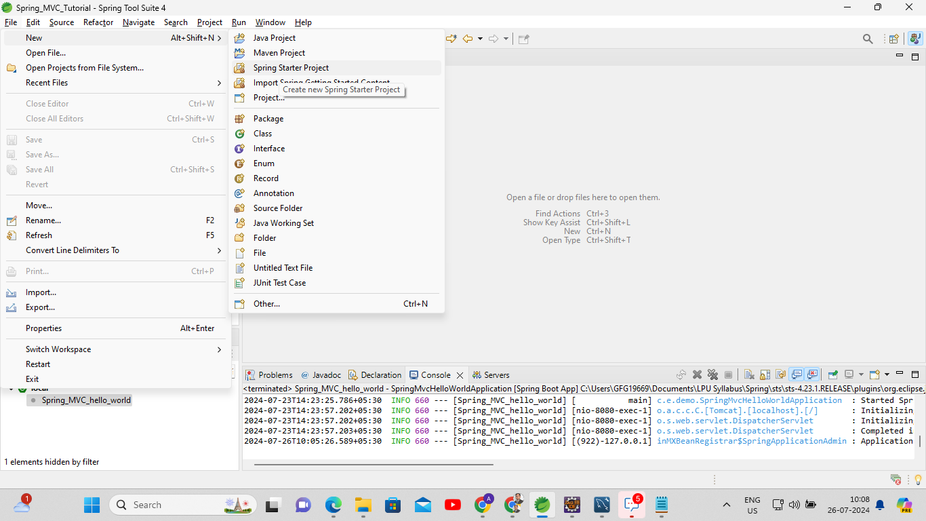

Slide 45
Lecture 01:Understanding MVC Concepts
History and Evolution of MVC
Origin of MVC Pattern
Components: Model, View, Controller
Responsibilities and Interactions

Slide 46
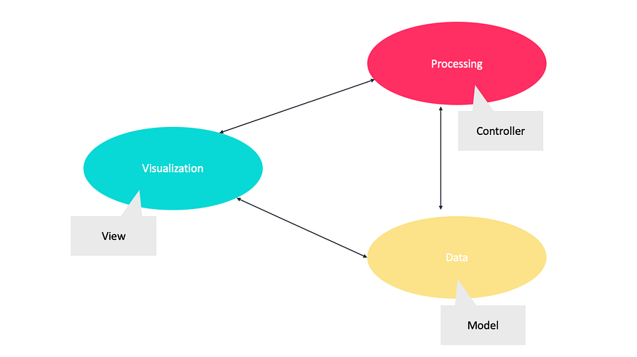
Why Model-View-(C or P or VM)?
Processing
Visualization
The aim of these architectures is to separate the responsibilities of
  visualizing,
  processing, and
  data management
for UI applications.
Data

Slide 47
Their goals are to increase.
Modularity
Flexibility
Testability
Maintainability

Slide 48
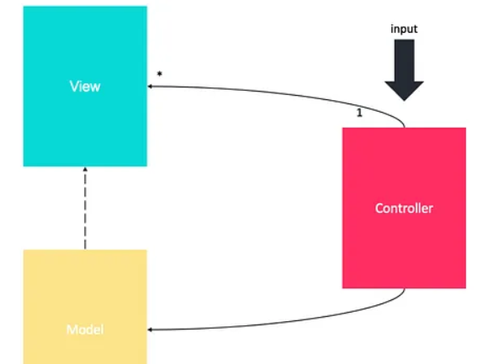
History and Evolution of MVC
The MVC pattern was first introduced in 1979 by computer scientist Trygve Mikkjel Heyerdahl Reenskaug.
Break up a complex user application into smaller manageable components.
First used in the programming language Small Talk.
The pattern breaks an app up into three components.

Slide 49
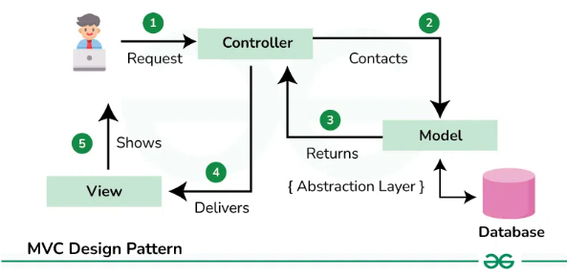
Model–View–Controller is a popular software design pattern
  Model – business layer of the application
  View – presentation of the application
  Controller – flow of the application
Notes:
Design Pattern, in software engineering, is a technique to solve a commonly occurring problem when designing software.
Designing Model, specifies what type of architecture you use to solve the problem or design the model.

Slide 50
Model — is responsible for the
  business logic of the application.
  It manages the state of the application. even include tasks related to data management such as networking and data validation.
View — this component has two important tasks: presenting data to the user and handling user interaction.
Controller — the view layer and the model layer are glued together by one or more controllers.
Notes:
It manages the state of the application. This also includes reading and writing data, persisting application state, and it may even include tasks related to data management such as networking and data validation.

Slide 51
How It Works
Initialization: The model is populated with data (simulated as coming from a database).
View Interaction: The controller updates the view with the initial model data.
Model Update: The controller modifies the model (changing the roll number).
View Update: The controller updates the view again to reflect the changes in the model.

Slide 52
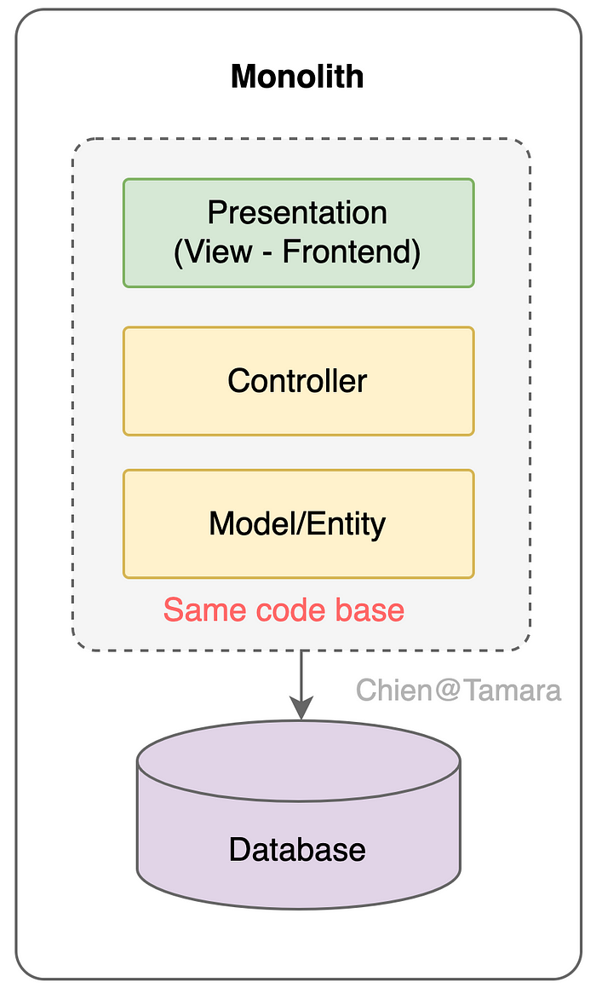
Comparison with Traditional Monolithic Architecture
View
Controller
Model

Slide 53
Advantages of MVC
Rapid Development and Growth:
  Monolithic applications can be developed and deployed quickly due to the unified codebase.
Code Reuse:
  Shared models or entities can be reused throughout the codebase, promoting efficiency.
High Degree of Uniformity:
  This architecture encourages a consistent coding approach.

Slide 54
Disadvantages
Maintenance Cost:
  As the application grows, maintaining and updating the code can become complex and costly.
Side Effects:
  Changes in one section of the code can have unintended effects elsewhere (also known as ‘ripple effects’).
Scaling:
  Horizontal scaling, or adding more machines to handle the increased load, can be challenging with this architecture.

Slide 55
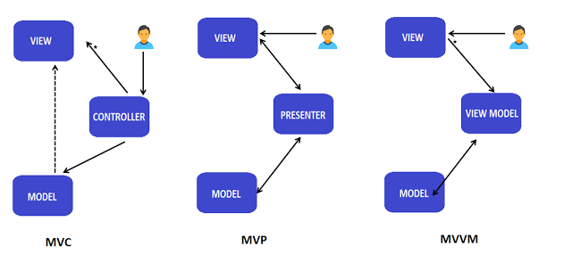
MVC – Model View Controller
MVP – Model View Presenter
MVVM – Model View View-Model

Slide 56
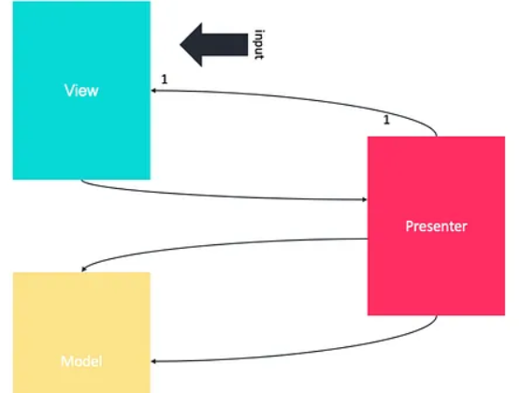
Model–View–Presenter
MVP is a derivative of the MVC design pattern which focuses on improving presentation logic.
It originated at a company named Taligent in the early 1990s while they were working on a model for a C++ CommonPoint environment.
View
Presenter
Model

Slide 57
Model — The Model represents a set of classes that describes the business logic and data. It also defines business rules for data means how the data can be changed and manipulated.
View — The View is used for making interactions with users like XML, Activity, fragments. It has got nothing to do with the logic that is to be implemented in the process.
Presenter — The presenter gets the input from the View, processes the data with the help of the Model, and passes the results back to the View after the processing is done.

Slide 58
MVP
Model:
Layer for storing data.
It is responsible for handling the domain logic(real-world business rules) and communication with the database and network layers.
View:
UI(User Interface) layer.
It provides the visualization of the data and keep a track of the user’s action in order to notify the Presenter.
Presenter:
Fetch the data from the model and applies the UI logic to decide what to display.
It manages the state of the View and takes actions according to the user’s input notification from the View.

Slide 59
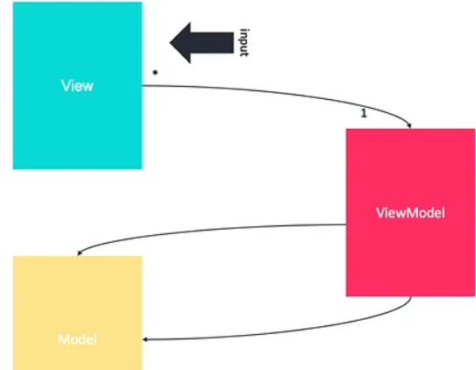
Model-View-ViewModel
MVVM was originally defined by Microsoft for use with Windows Presentation Foundation (WPF) and Silverlight,
This pattern based on MVC and MVP which attempts to more clearly separate the development of UI from that of the business logic and behavior in an application.
View
View Model
Model

Slide 60
View: This is what the user sees and interacts with. It’s the UI layer, like buttons, text boxes, and labels.
Model: This represents the data and business logic. It’s where the application’s core functionality lives, such as calculations, data retrieval, and state management.
ViewModel: This acts as an intermediary between the View and the Model. It’s not just a direct link but an abstraction:
  the ViewModel translates data from the Model into a format that the View can display
  and also exposes commands that the View can use to interact with the Model.

Slide 61
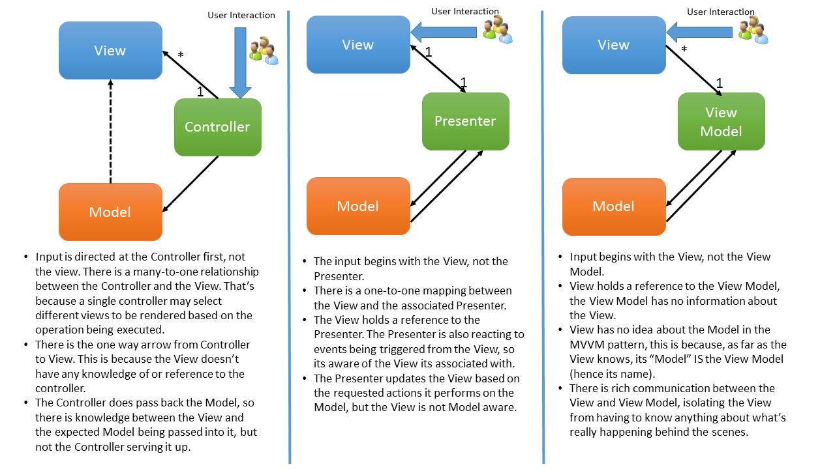

Slide 62
Maven is a powerful project management and build automation tool primarily used in Java projects.
It simplifies the process of managing project dependencies, building, and deploying applications.

Slide 63
Why Do We Need Maven?
When developing a project, several tasks must be managed:
  Compilation: Converting source code into bytecode.
  Execution: Running the compiled code.
  Testing: Ensuring the code works as expected.
  Packaging: Bundling the code into a distributable format (like JAR files).
  Deployment: Deploying the packaged code to a server or repository.
While IDEs like IntelliJ or Eclipse can handle these tasks, Maven provides a more streamlined and consistent approach.

Slide 64
Dependency Management
In software development, dependencies are external libraries your project relies on. Handling these manually involves several challenges:
  Downloading Dependencies: Searching and downloading the required JAR files for your project.
  Version Compatibility: Ensuring all dependencies are compatible with each other (e.g., a specific version of Spring might only work with certain versions of Hibernate).
  Transitive Dependencies: Some libraries depend on other libraries, leading to a complex web of dependencies.
  Team Collaboration: Ensuring all team members use the same versions of dependencies.
Maven simplifies these tasks by managing dependencies through a central configuration file.

Slide 65
Maven vs. Manual Management
Without Maven:
Developers search for and download each JAR file manually.
Dependencies and their versions need to be managed manually.
Ensuring compatibility between dependencies is a manual process.
Sharing projects with others requires them to manually set up the same dependencies.
With Maven:
Dependencies are declared in a single file (pom.xml).
Maven automatically downloads and includes the specified versions of the required libraries.
It resolves transitive dependencies (libraries that your dependencies depend on).
Consistency across different environments and team members is maintained.

Slide 66
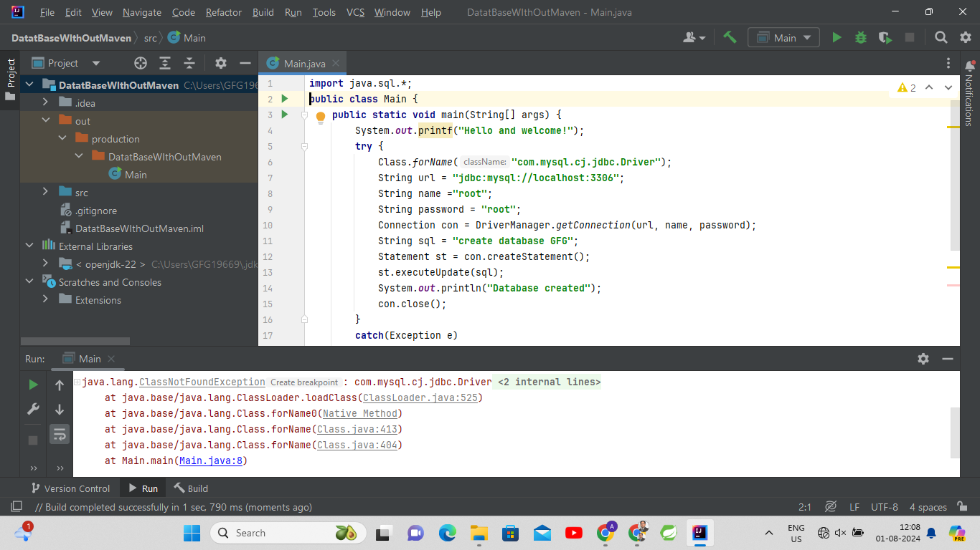
Without Maven

Slide 67
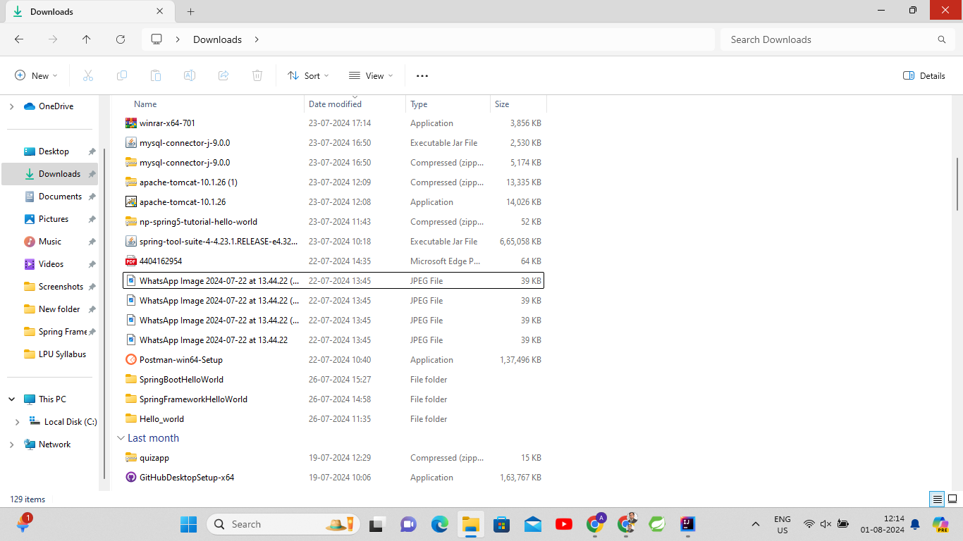
Get the required jar file

Slide 68
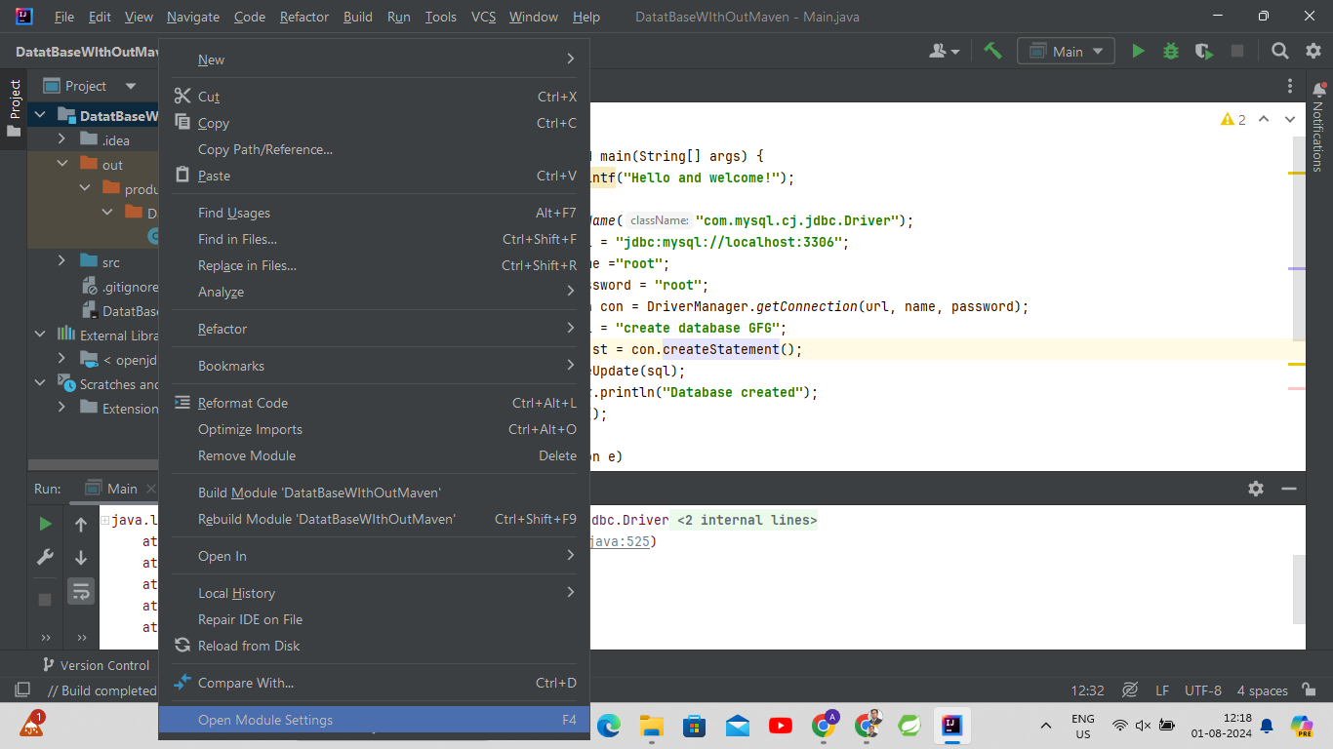

Slide 69
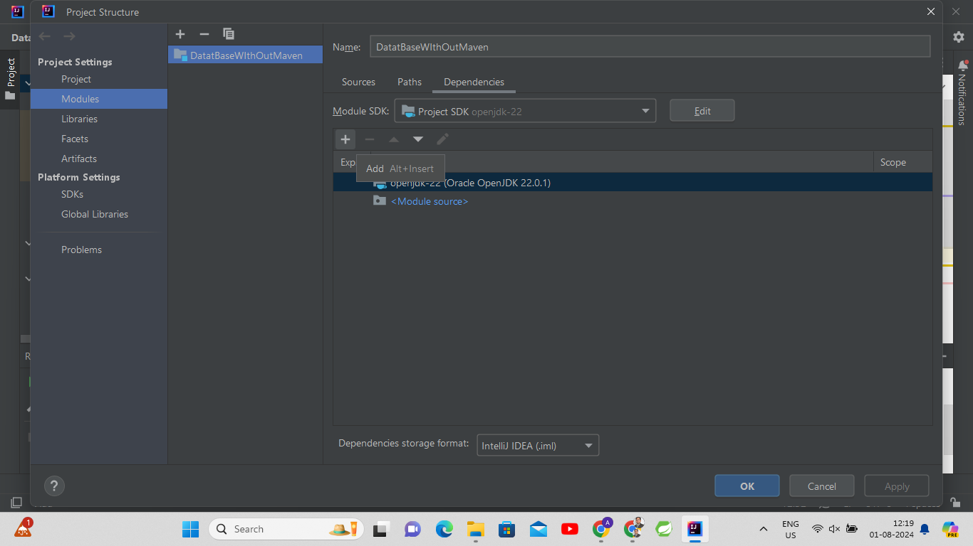

Slide 70
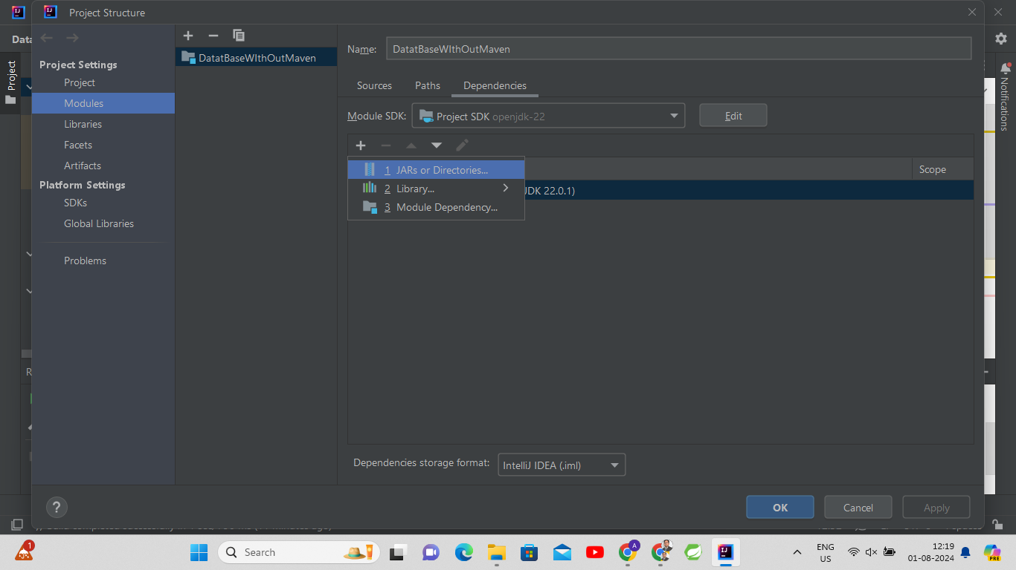

Slide 71
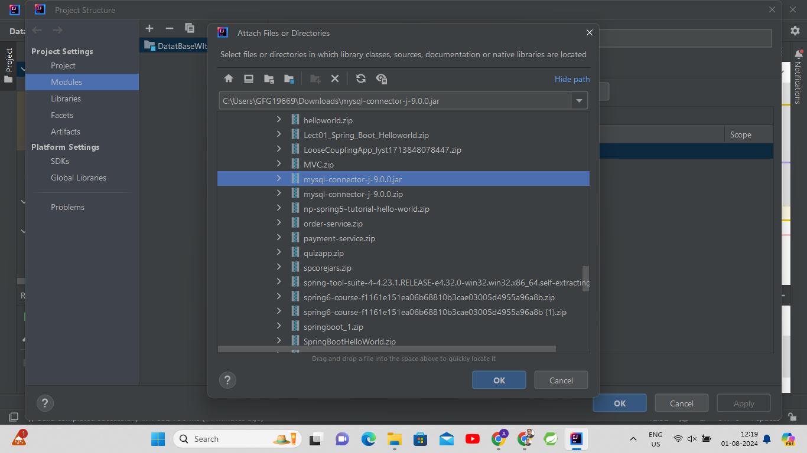

Slide 72
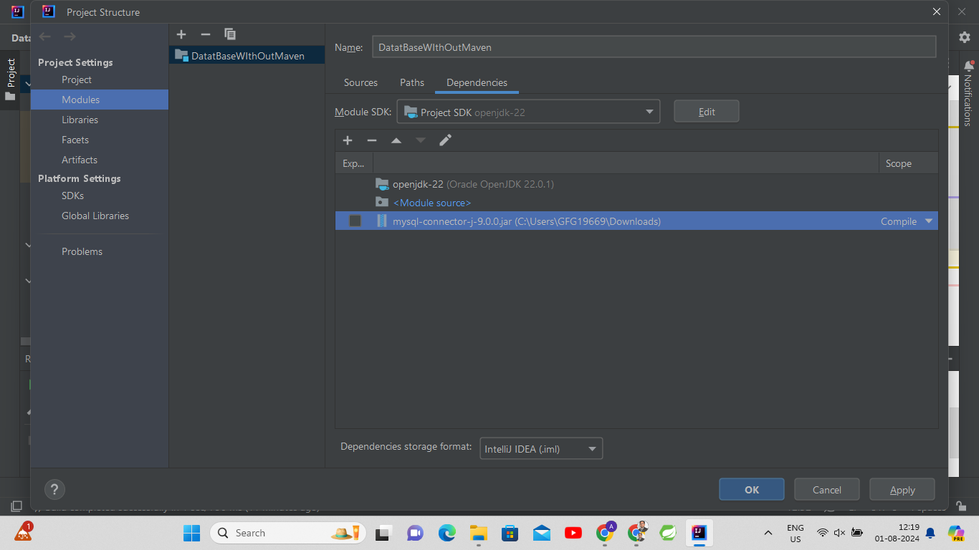

Slide 73
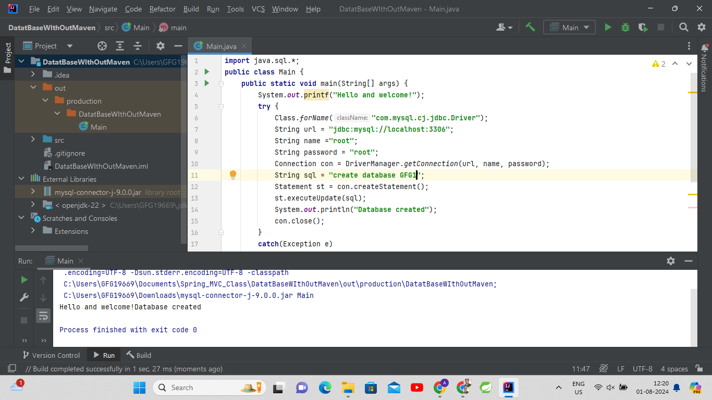

Slide 74
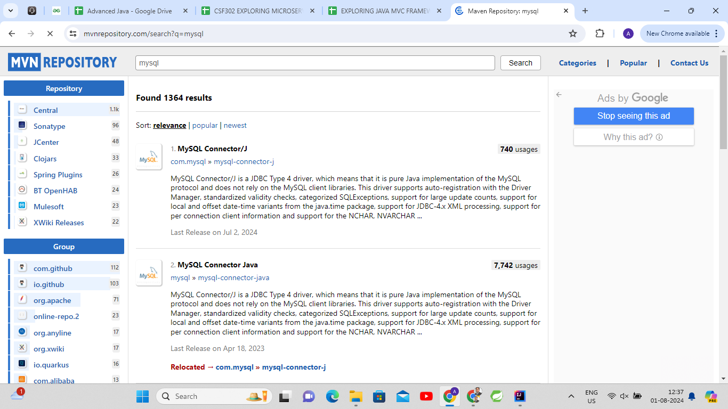

Slide 75
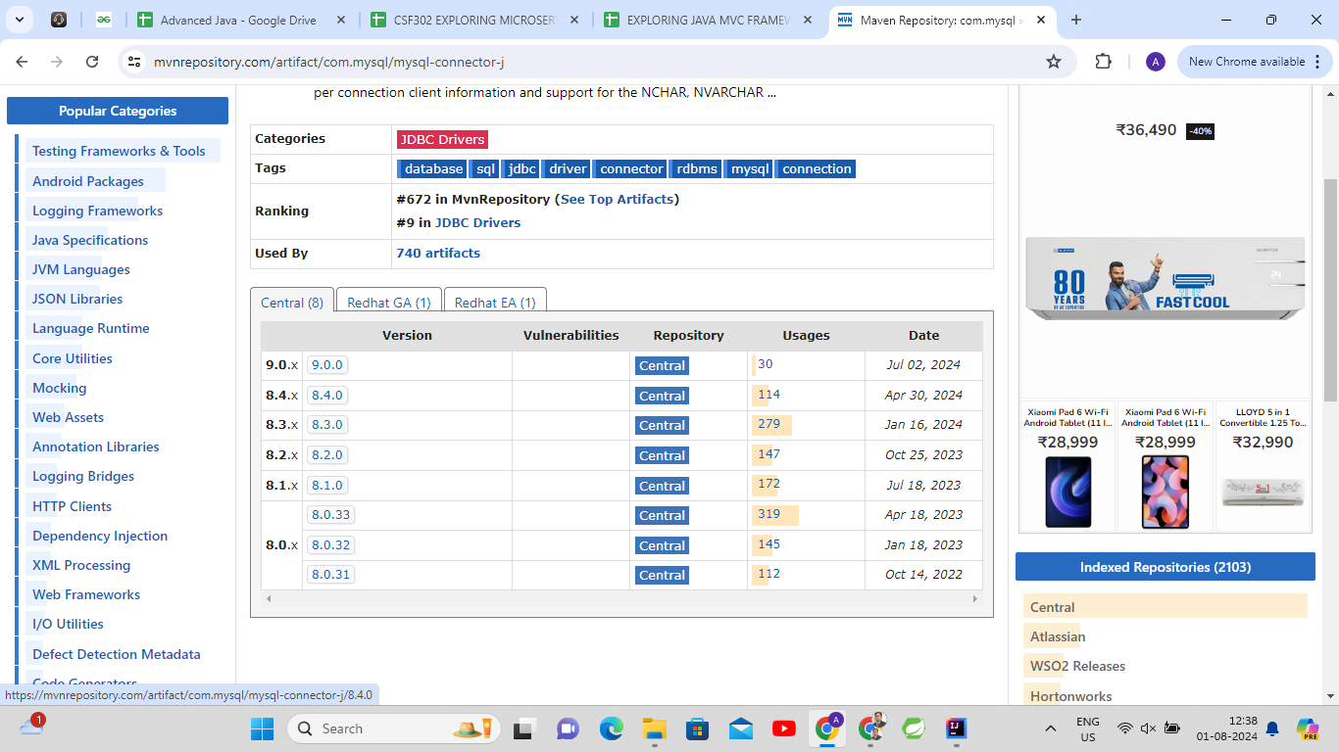

Slide 76
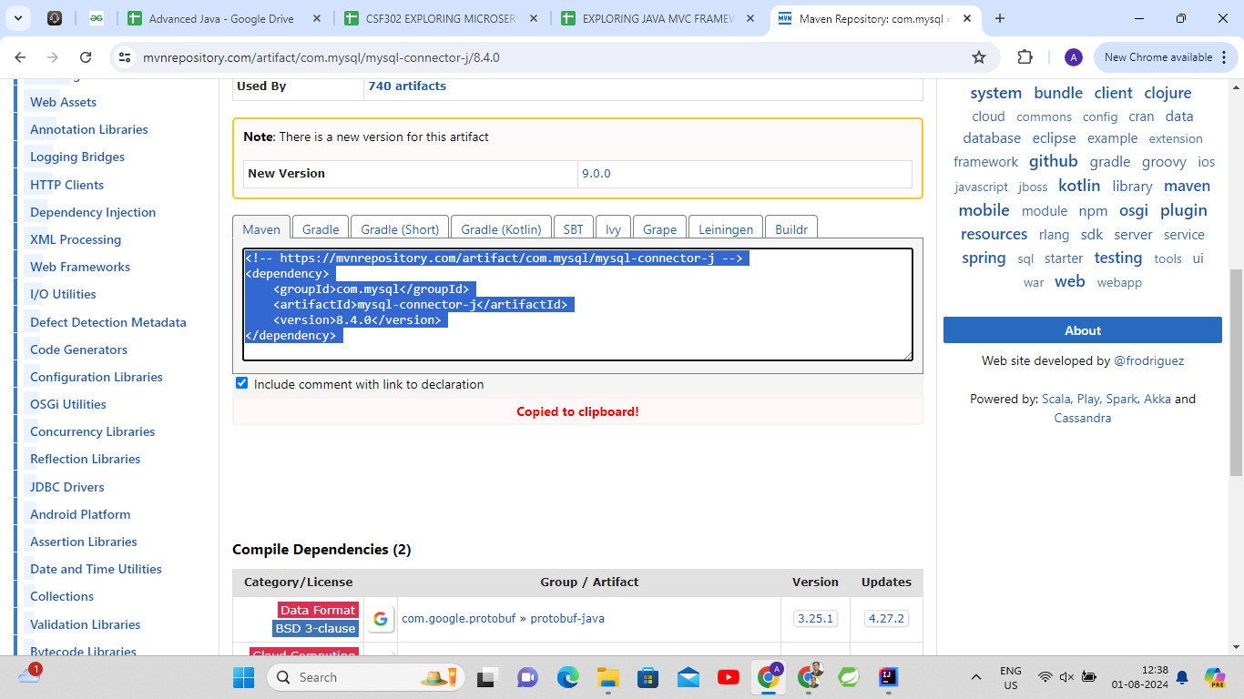

Slide 77
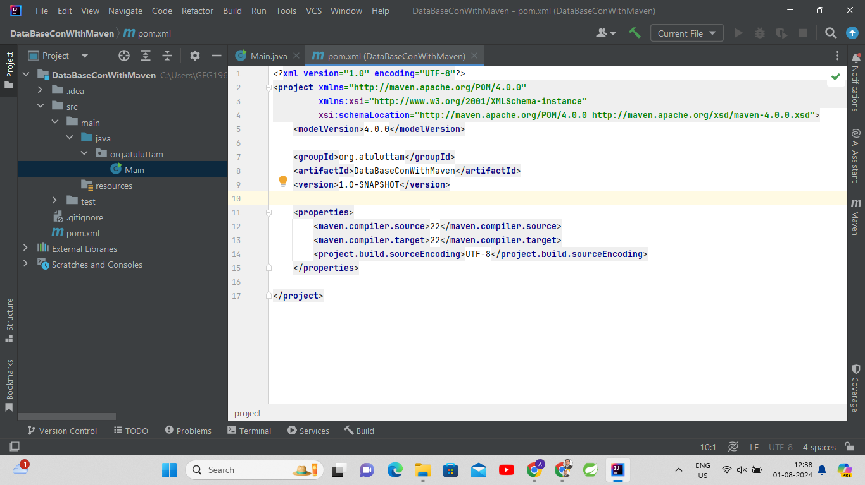

Slide 78
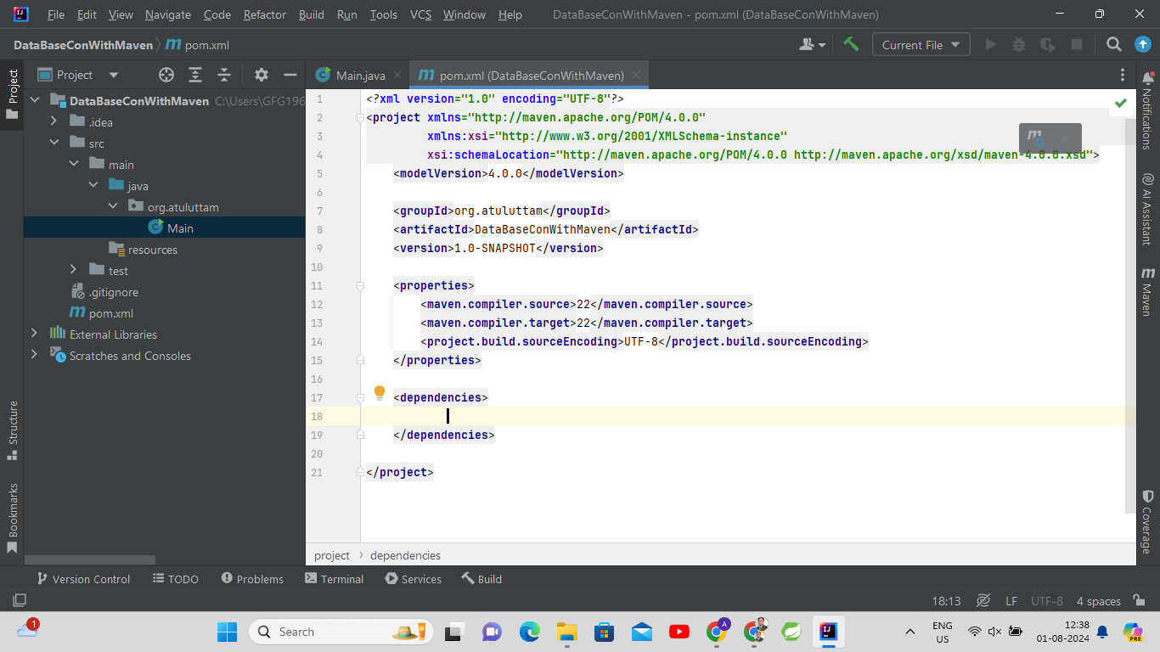

Slide 79
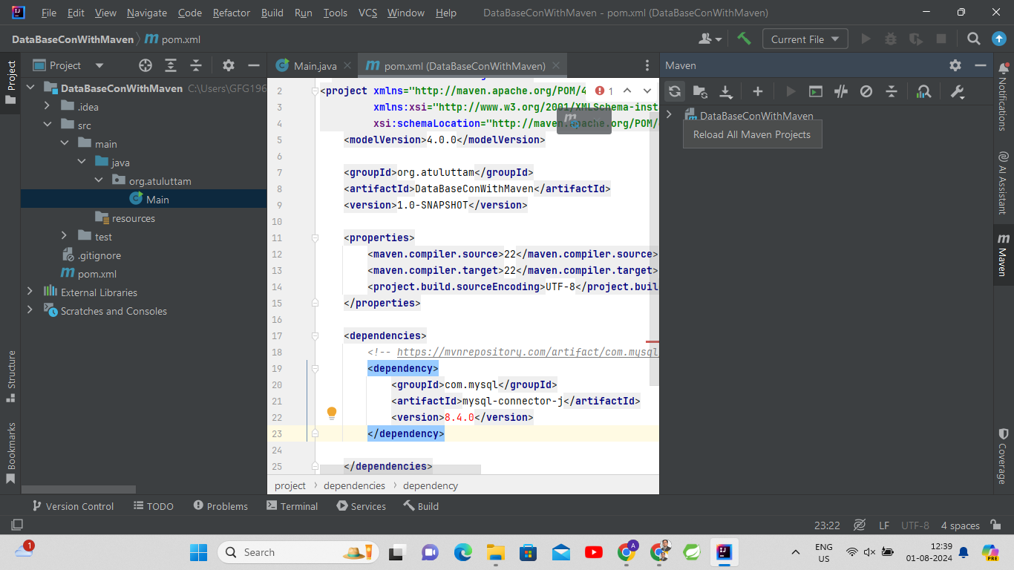

Slide 80
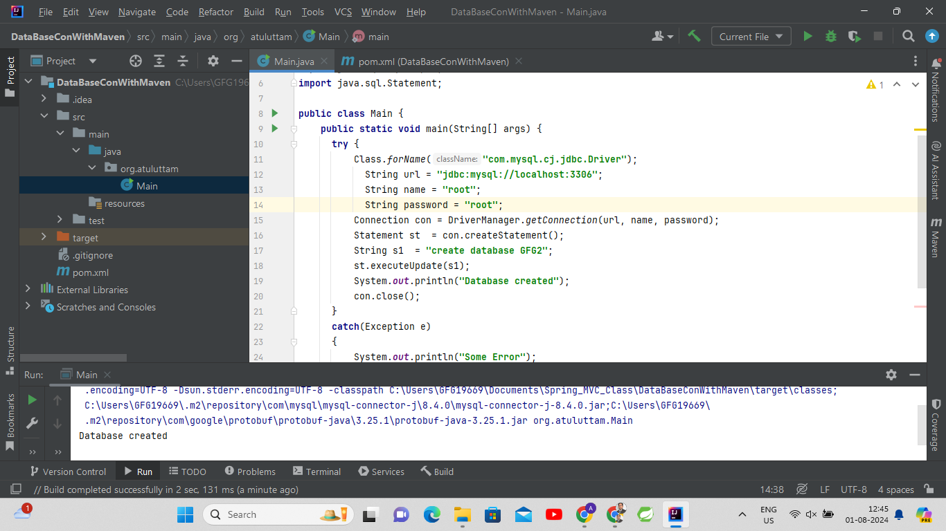

Slide 81
package org.example;
import java.sql.*;
public class Main {
public static void main(String[] args) {
try
{
Class.forName("com.mysql.cj.jdbc.Driver");
String url = "jdbc:mysql://localhost:3306";
String username = "root";
String password = "root";
Connection con = DriverManager.getConnection(url, username, password);
String q = "create database GFG1";
Statement stmt = con.createStatement();
stmt.executeUpdate(q);
System.out.println("database created");
con.close();
}
catch(Exception e)
{
e.printStackTrace();
}
}
}

Slide 82
<?xml version="1.0" encoding="UTF-8"?>
<project xmlns="http://maven.apache.org/POM/4.0.0"
xmlns:xsi="http://www.w3.org/2001/XMLSchema-instance"
xsi:schemaLocation="http://maven.apache.org/POM/4.0.0 http://maven.apache.org/xsd/maven-4.0.0.xsd">
<modelVersion>4.0.0</modelVersion>
<groupId>org.example</groupId>
<artifactId>MavenDemo</artifactId>
<version>1.0-SNAPSHOT</version>
<dependencies>
<!-- https://mvnrepository.com/artifact/com.mysql/mysql-connector-j -->
<dependency>
<groupId>com.mysql</groupId>
<artifactId>mysql-connector-j</artifactId>
<version>8.2.0</version>
</dependency>
</dependencies>
<properties>
<maven.compiler.source>21</maven.compiler.source>
<maven.compiler.target>21</maven.compiler.target>
<project.build.sourceEncoding>UTF-8</project.build.sourceEncoding>
</properties>
</project>

Slide 83
Maven Workflow
Project Setup: Define project metadata and dependencies in pom.xml.
Dependency Resolution: Maven downloads the specified dependencies from a central repository.
Build Lifecycle: Maven defines a standard build lifecycle that includes:
  validate: Validates the project is correct.
  compile: Compiles the source code.
  test: Runs tests.
  package: Packages the compiled code into a JAR or WAR.
  verify: Runs checks to ensure package quality.
  install: Installs the package into the local repository.
  deploy: Deploys the package to a remote repository for sharing.

Slide 84
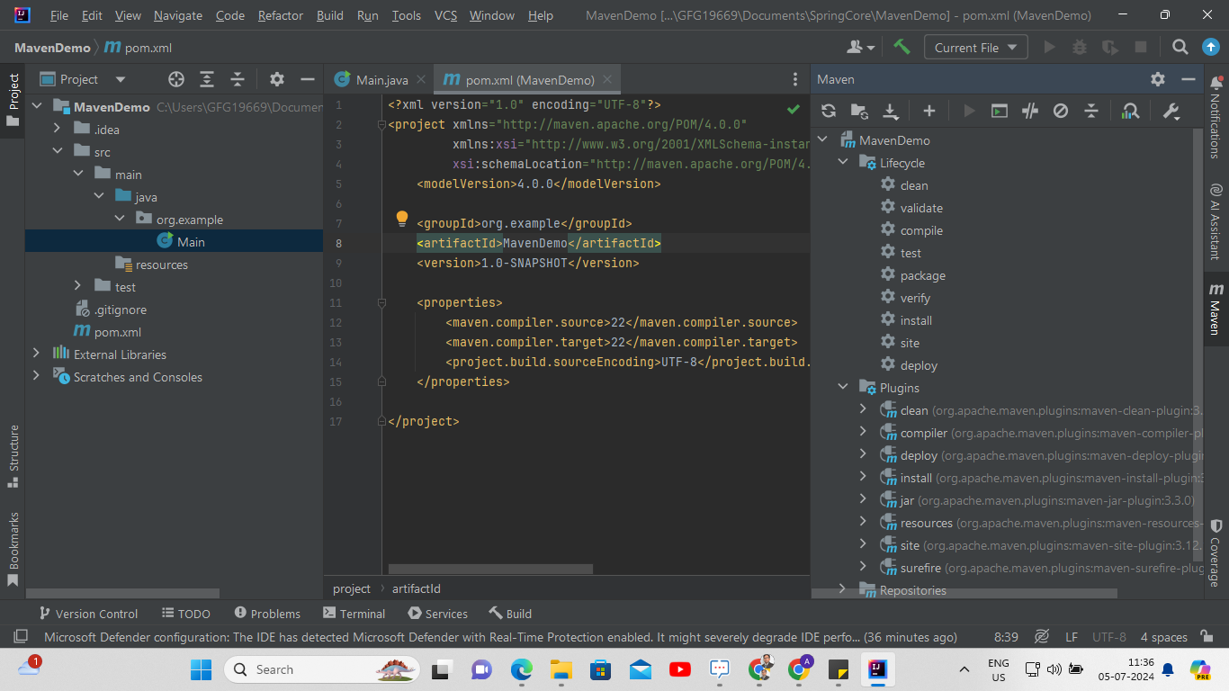

Slide 85
Alternatives to Maven
Other tools available for project management and build automation include:
Gradle: A flexible build automation tool that can handle complex project structures.
Ant with Ivy: Ant is a build tool, and Ivy provides dependency management for Ant.
While Gradle is powerful and flexible, Maven is often considered more beginner-friendly and straightforward for those new to Java project development.

Slide 86
Objective Questions on Maven
What is Maven primarily used for in Java projects?
A. Managing dependencies
B. Writing code
C. Debugging applications
D. Designing user interfaces

Slide 87
Answer: A. Managing dependencies

Slide 88
Which file in a Maven project defines the project’s dependencies and build configuration?
A. build.xml
B. pom.xml
C. settings.xml
D. config.xml

Slide 89
Answer: B. pom.xml

Slide 90
What is one of the main advantages of using Maven for managing project dependencies?
A. Maven automatically writes code.
B. Maven enforces coding standards.
C. Maven handles the downloading and inclusion of specified versions of libraries.
D. Maven converts Java code into machine code.

Slide 91
Answer: C. Maven handles the downloading and inclusion of specified versions of libraries.

Slide 92
How does Maven help when sharing a project with others?
A. By embedding all dependencies in the project files.
B. By providing a pom.xml file that lists all required dependencies and their versions.
C. By creating an executable that includes all dependencies.
D. By manually copying all dependencies to each team member's machine.

Slide 93
Answer: B. By providing a pom.xml file that lists all required dependencies and their versions.

Slide 94
What does the acronym “POM” stand for in Maven?
A. Project Object Model
B. Package Option Module
C. Process Operation Manager
D. Project Oriented Management

Slide 95
Answer: A. Project Object Model

Slide 96
What type of file format do Maven projects typically package their compiled code into?
A. WAR
B. ZIP
C. TAR
D. JAR

Slide 97
Answer: D. JAR

Slide 98
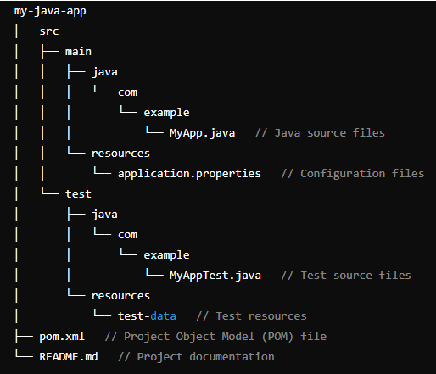
Maven Project Structure (Standard Directory Layout)

Slide 99
src/main/java: This directory contains the Java source code files of your application. They are typically organized under a package structure (com.example in this example).
src/main/resources: Configuration files and other resources that should be included in the packaged JAR or WAR file.
src/test/java: Test source code files, following a similar structure to src/main/java. These are used for unit testing and integration testing.

Slide 100
src/test/resources: Resources for testing purposes, such as test data files.
pom.xml: The Project Object Model (POM) file for Maven. It contains configuration details about the project and its dependencies.
README.md: Documentation file that typically provides information about the project, how to set it up, and how to use it.

Slide 101
POM (Project Object Model) File Structure
The pom.xml file contains information of project and configuration information for the maven to build the project such as dependencies, build directory, source directory, test source directory, plugin, goals etc.
Maven reads the pom.xml file, then executes the goal.
Before maven 2, it was named as project.xml file.
But, since maven 2 (also in maven 3), it is renamed as pom.xml.

Slide 102
Elements of maven pom.xml file
Element | Description
project | It is the root element of pom.xml file.
modelVersion | It is the sub element of project. It specifies the modelVersion. It should be set to 4.0.0.
groupId | It is the sub element of project. It specifies the id for the project group.
artifactId | It is the sub element of project. It specifies the id for the artifact (project).
version | It is the sub element of project. It specifies the version of the artifact under given group.

Slide 103
<?xml version="1.0" encoding="UTF-8"?>
<project xmlns="http://maven.apache.org/POM/4.0.0"
xmlns:xsi="http://www.w3.org/2001/XMLSchema-instance"
xsi:schemaLocation="http://maven.apache.org/POM/4.0.0 http://maven.apache.org/xsd/maven-4.0.0.xsd">
<!-- Project metadata -->
<modelVersion>4.0.0</modelVersion>
<groupId>org.example</groupId>
<artifactId>MavenDemo</artifactId>
<version>1.0-SNAPSHOT</version>
<properties>
<maven.compiler.source>22</maven.compiler.source>
<maven.compiler.target>22</maven.compiler.target>
<project.build.sourceEncoding>UTF-8</project.build.sourceEncoding>
</properties>
</project>

Slide 104
Maven pom.xml file with additional elements
Element | Description
packaging | defines packaging type such as jar, war etc.
name | defines name of the maven project.
url | defines url of the project.
dependencies | defines dependencies for this project.
dependency | defines a dependency. It is used inside dependencies.
scope | defines scope for this maven project. It can be compile, provided, runtime, test and system.

Slide 105
<project xmlns="http://maven.apache.org/POM/4.0.0" xmlns:xsi="http://www.w3.org/2001/XMLSchema-instance"
xsi:schemaLocation="http://maven.apache.org/POM/4.0.0 http://maven.apache.org/xsd/maven-4.0.0.xsd">
<modelVersion>4.0.0</modelVersion>
<groupId>com.javatpoint.application1</groupId>
<artifactId>my-application1</artifactId>
<version>1.0</version>
<packaging>jar</packaging>
<name>Maven Quick Start Archetype</name>
<url>http://maven.apache.org</url>
<dependencies>
<dependency>
<groupId>junit</groupId>
<artifactId>junit</artifactId>
<version>4.8.2</version>
<scope>test</scope>
</dependency>
</dependencies>
</project>

Slide 106
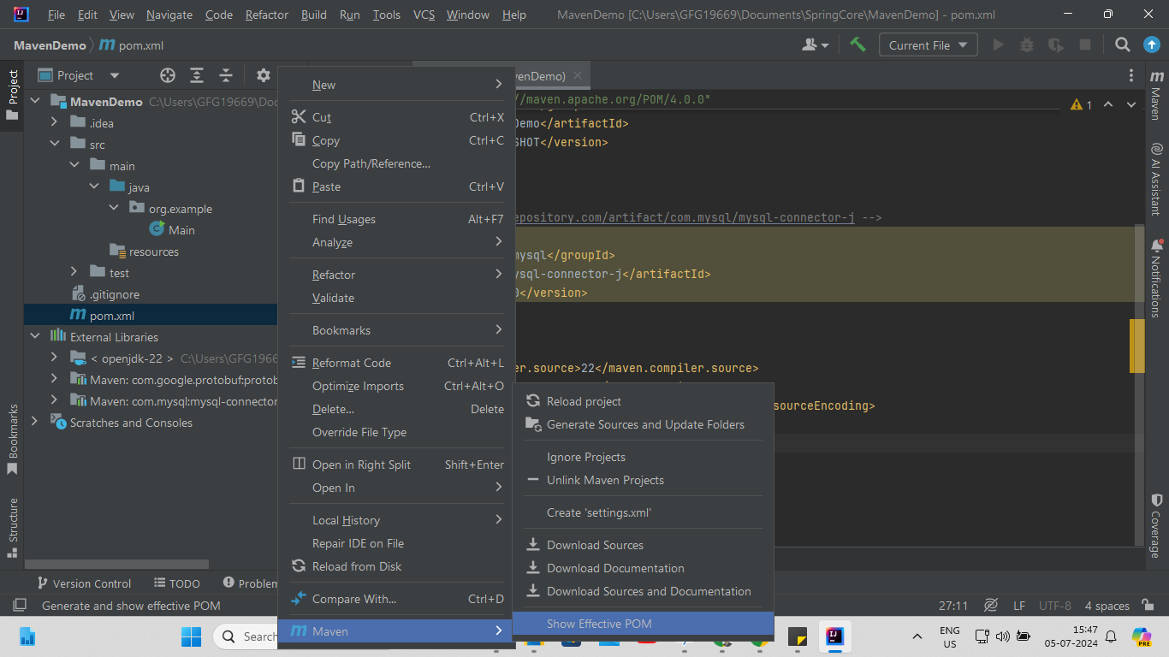

Slide 107
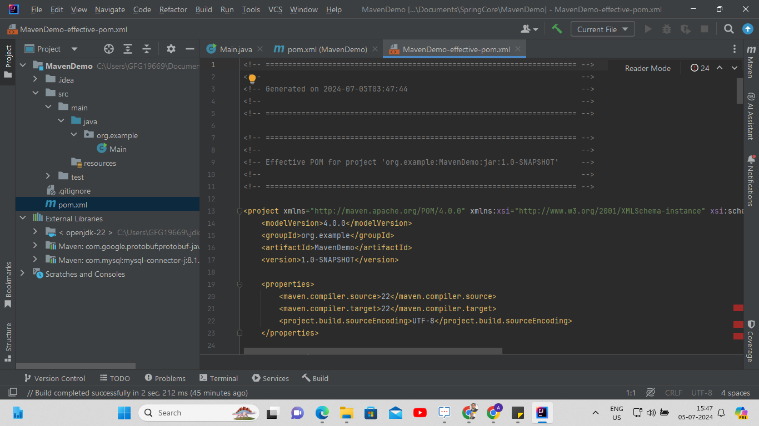

Slide 108

Importance of Web Applications
Web applications are essential in today's world, complementing mobile applications.
Both mobile and web applications often share the same backend server.

Slide 109
Spring Framework
Spring is an umbrella framework containing multiple projects for various purposes.
Spring Web: Used for building web applications.
Spring MVC: Another option within Spring for web applications.
Both aim to simplify backend development for dynamic web content.

Slide 110
Building Web Applications
Dynamic content requires backend programming, often in Java.
Backend servers handle client requests, process them, and return data, usually in JSON format.
The backend can interact with databases or other servers to fetch data.

Slide 111
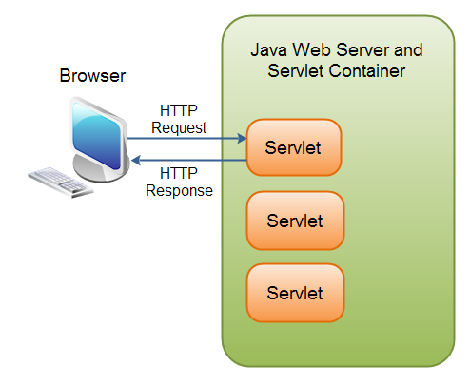
Servlets
Servlets: Java components that process client requests and generate responses.
They run on a servlet container (or web container) which handles HTTP requests and responses.

Slide 112

Apache Tomcat
Tomcat: A lightweight and popular servlet container for running Java servlets.
Provides the environment necessary for servlets to function, including handling requests from the internet.

Slide 113
Relation Between Spring and Servlets
Even when using Spring (e.g., Spring MVC or Spring Web), servlets operate behind the scenes.
Spring simplifies the use of servlets and enhances functionality.

Slide 114
Key Features
Servlet Container:
Tomcat implements the Java Servlet, JavaServer Pages (JSP), and Java Expression Language (EL) specifications.
This makes it suitable for running web applications that use these technologies.
Web Server:
It can serve static content (like HTML, CSS, JavaScript files) in addition to dynamic content generated by servlets and JSPs.
Lightweight:
Compared to full-fledged application servers like JBoss or WebSphere, Tomcat is lightweight and more focused on web applications, making it easier to manage and faster to start up.
Extensible and Flexible:
Tomcat can be extended and customized using its extensive configuration options and support for adding additional modules.

Slide 115
History of Apache Tomcat
As the reference implementation of Java Servlet and Java Server Pages (JSP), Tomcat was started at Sun Microsystems, which later donated the code base to the Apache Software Foundation in 1999.
Nowadays, Apache Tomcat is widely used by many companies as it implements many of the Jakarta EE specifications such as:
  Java Servlet
  JavaServer Pages
  Java Expression Language
  Java WebSockets

Slide 116
Key primary terminologies and functionalities
Servlet Container: it gives a runtime environment to Java Servlets to run inside a web server. Servlets are Java classes that powerfully interaction sends requests and generate reactions to that requests making them a critical division for Java-based web application.
JSP Support: Tomcat supports JavaServer Pages (JSP), which are HTML pages with embedded Java code. JSP allows developers to create dynamic web pages by combining static content with Java code, which gets executed on the server-side before sending the response to the client.
Jakarta EE Compatibility: it also supports various Java EE (Enterprise Edition) specifications to some extent, including Servlet, JSP, EL (Expression Language), JSTL (JavaServer Pages Standard Tag Library), WebSocket, and more.
HTTP Server: Tomcat includes a built-in HTTP server that listens for and processes HTTP requests. This server component enables Tomcat to function as a standalone web server, capable of serving static content as well as dynamic Java-based web applications.

Slide 117


Slide 118
Spring Framework
Spring is a lightweight and popular open-source Java-based framework developed by Rod Johnson in 2003.
It is used to develop enterprise-level applications.
It provides support to many other frameworks such as Hibernate, EJB, Struts, etc, so it is also called a framework of frameworks.
It’s an application framework and IOC (Inversion of Control) container for the Java platform.
The spring contains several modules like IOC, AOP, DAO, Context, WEB MVC, etc.

Slide 119
Why to use Spring?
It is a highly acceptable framework in java by the industry because of below features:
  Light-Weight: Spring has dominated EJB in no time because of its light-weight feature. EJB was heavy-weight in comparison to Spring.
  Open-Source: It is open source software, easily installable, so adapted by industry very quickly.
  Modular Architecture: It has multiple modules, we can use each module independently as per our requirement.
  Easy to develop Application: As it already has frequently used functionalities of an application built-in into it by default, the developer needs to focus on application’s business logic only.

Slide 120
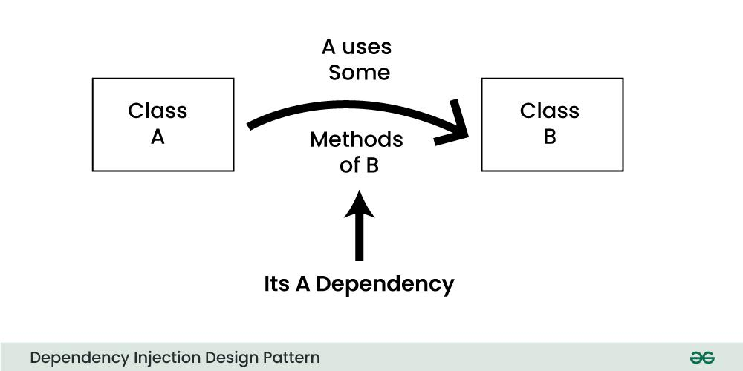
Dependency Injection
Dependency Injection (DI) design pattern is a technique that reduces the connection between system components, making the code more modular, testable, and maintainable.
Classes frequently rely on other classes to carry out their tasks in a typical software program.
DI allows you to "inject" the things a class needs (its dependencies) from the outside, instead of letting the class create or manage them itself.
For Example:
Car class might depend on a Engine class to run.
Without DI, the Car class would directly create or manage the Engine instance within its code, which makes the two classes tightly coupled.
This approach can create problems, particularly when you need to test, extend, or modify the classes in the future.

Slide 121
AOP Support
It reduces boilerplate code via AOP (Aspect Oriented Programming) support.
For example, common connection preparation logic in JDBC comes under boilerplate code.
By applying AOP, developers can flawlessly integrate features like logging, security, and transaction management into their applications without modifying the primary structure of the code base.

Slide 122
Bean in Spring
A bean is a Java class that contains state and behavior with a condition that state must be used in the business logic of the behavior.
The non-static member variables represent the state of the class.
On the other hand, methods represent the behavior of the class.
A Java class whose object is created and managed by the Spring Container is called a Spring Bean.
We can consider any class as a Spring Bean, except an abstract class and an interface.

Slide 123
Mark a class as a Bean in Spring
1. Using XML Configuration File
Use <bean> tag in the configuration file to mark a Java class as a Spring Bean.
This configuration file provides instructions to the Spring Container to consider the class as a Spring Bean.
Spring Container handles the whole life cycle of that Spring Bean.
<bean id="employee" class="com.dev.example.Employee"/>

Slide 124
Key Attributes of the <bean> Tag
id:
Description: A unique identifier for the bean within the Spring container.
name:
Description: An alias for the bean. A bean can have multiple aliases in addition to its id.
<bean id = "myBean" class = "com.example.MyClass"/>
<bean id = "myBean" name = "beanAlias" class = "com.example.MyClass"/>

Slide 125
class:
Description: The fully qualified class name of the bean. It tells Spring what class to instantiate when creating the bean.
scope:
Description: Defines the scope of the bean, which determines its lifecycle. Common scopes are:
  singleton: A single instance of the bean is created (default scope).
  prototype: A new instance is created each time the bean is requested.
  request, session: Scopes specific to web applications.
<bean id = "myBean" class = "com.example.MyClass" scope = "prototype"/>

Slide 126
autowire:
Description: Specifies the autowiring mode for dependency injection.
  no: Default mode, where no autowiring is done.
  byName: Autowires by matching the property name to the bean name.
  byType: Autowires by matching the property type to the bean type.
  constructor: Autowires via constructor injection.
<bean id = "myBean" class = "com.example.MyClass" autowire = "byType"/>

Slide 127
no (Manual Wiring)
This is the default mode, where no autowiring takes place. You manually wire dependencies using the <property> element.
<beans> <!-- Defining beans with explicit dependency injection -->
<bean id = "engine" class = "com.example.Engine" />
<bean id = "car" class = "com.example.Car">
<!-- Explicitly setting the dependency -->
<property name = "engine" ref = "engine" />
</bean>
</beans>

Slide 128
public class Engine {
public void start() {
System.out.println("Engine started!");
}
}
public class Car
{​
private Engine engine;​
// Setter method to inject dependency​
public void setEngine(Engine engine) {​
this.engine = engine;​
}​
public void drive()
{​
engine.start();​
System.out.println("Car is driving...");​
}​
}​

Slide 129
2. byName
In this mode, Spring attempts to autowire by matching the property name to a bean name in the context.
<beans>
<bean id = "engine" class = "com.example.Engine" />
<bean id = "car" class= "com.example.Car" autowire = "byName" />
</beans>

Slide 130
public class Engine {
public void start() {
System.out.println("Engine started!");
}
}
public class Car {
// Property name matches the bean name "engine"
private Engine engine;
// Setter method
public void setEngine(Engine engine) {
this.engine = engine;
}
public void drive() {
engine.start();
System.out.println("Car is driving...");
}
}

Slide 131
3. byType
Spring matches the type of the property with the type of the bean available in the container.
If there is exactly one matching bean, it will be injected.
If there are multiple matching beans, you will get an exception.
<beans>
<bean id = "engine" class = "com.example.Engine" />
<bean id = "car" class = "com.example.Car" autowire = "byType" /> </beans>

Slide 132
public class Engine {
public void start() {
System.out.println("Engine started!");
}
}
public class Car {
// Property of type Engine
private Engine engine;
// Setter method
public void setEngine(Engine engine) {
this.engine = engine;
}
public void drive() {
engine.start();
System.out.println("Car is driving...");
}
}

Slide 133
4. constructor
With this mode, Spring autowires dependencies via the constructor of the bean. It attempts to match the constructor arguments with the beans available in the Spring context by type.
<beans>
<bean id = "engine" class = "com.example.Engine" />
<bean id = "car" class = "com.example.Car" autowire = "constructor" /> </beans>

Slide 134
public class Engine {
public void start() {
System.out.println("Engine started!");
}
}
public class Car {
private Engine engine;
// Constructor-based dependency injection
public Car(Engine engine)
{
this.engine = engine;
}
public void drive() {
engine.start();
System.out.println("Car is driving...");
}
}

Slide 135
lazy-init:
Determines whether the bean should be lazily initialized or not.
When set to true, the bean will not be instantiated until it is first requested, instead of during the Spring container startup.
<bean id = "myBean" class = "com.example.MyClass" lazy-init = "true"/>

Slide 136
primary:
When multiple beans of the same type are available, primary="true" can be used to mark one of them as the preferred bean to be injected by default.
<bean id = "myPrimaryBean" class = "com.example.MyClass" primary = "true"/>

Slide 137
constructor-arg:
Description: Specifies arguments to pass to the bean’s constructor. This is used for constructor injection.
<bean id = "myBean" class = "com.example.MyClass">
<constructor-arg value = "someValue"/>
</bean>

Slide 138
Mark a class as a Bean in Spring
2. Using Annotation
@Component it is considered as a Spring Bean by the Spring Container.
@Component
public class Employee
{
. . . .
}
If we don’t specify any name, the class name with first letter in lower case will become the name of the Spring bean by default.
In this case it will be ’employee’.
However, we can provide the name of Spring Bean as @Component(“employee”).

Slide 139
Mark a class as a Bean in Spring
We also have various Stereotype annotations that we can use as an alternative to @Component, but we should use them at some specific scenario.
@Component is a class level annotation.
Other stereotypes are a specialization of @Component.
During the component scanning, Spring container automatically discovers the classes annotated with @Component, It registers them into the Application Context as a Spring Bean.

Slide 140
Mark a class as a Bean in Spring
3. Using Java-based Configuration
Since Spring 3.0, a pure-Java configuration container was provided.
XML configuration is completely removed in this approach.
The key features in Spring Framework’s new Java-configuration support are @Configuration annotated classes and @Bean annotated methods.
Using @Configuration annotation at any Java class represents that Spring container will consider it as a source of Bean’s definitions.
Using the @Bean tells the Spring container that method will return an object which should be registered as a Spring bean in the Spring container.

Slide 141
@Configuration
public class EmployeeConfig
{
@Bean
public Employee getEmployee()
{
return new Employee();
}
}

Slide 142
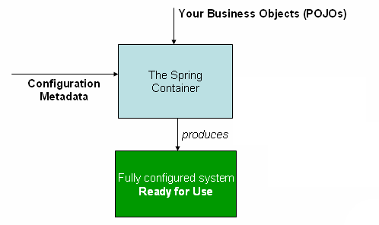
Spring Container
Spring Container is itself a program in Spring Framework that manages the objects.
The container gets its instructions by reading configuration metadata to instantiate, configure, and assemble the objects.
We can represent configuration metadata in different forms, such as: XML, Java annotations, or Java code.
  1) Find and Scan Spring Beans
  2) Create Objects for the beans that it found after scanning
  3) Link/Inject objects if they have some relations such as HAS-A
  4) Destroy the objects
The Spring IoC container

Slide 143
Types Of Spring Containers
Spring Framework provides two Java Interfaces that works as Spring Containers.
  Bean Factory
  ApplicationContext

Slide 144
Bean Factory
It supports only XML configuration.
It comes under package org.springframework.beans.
Now it is supposed as a legacy container.
Since we can’t create an object from an Interface in Java, the BeanFactory interface provides a most commonly used implementation class which is XmlBeanFactory.

Slide 145
ApplicationContext
Represents the Spring IoC container and is responsible for instantiating, configuring, and assembling the beans.
It supports all the forms of configuration: XML, Java and Annotation.
It comes under package org.springframework.context.
ApplicationContext provides multiple implementation classes such as:
  (A) ClassPathXmlApplicationContext : We should use it when configuration file is at project’s class path.
  (B) FileSystemXmlApplicationContext : We should use it when configuration file is at server’s file system.
  (C) AnnotationConfigApplicationContext : We should use it when we are using annotation-based configuration.

Slide 146
Create a Spring Container
ApplicationContext context = new ClassPathXmlApplicationContext("com/spring/example/config.xml");
we are using ClassPathXmlApplicationContext to create the container context and supplying configuration file named as config.xml (For XML-based configuration).
AnnotationConfigApplicationContext context = new AnnotationConfigApplicationContext(AppConfig.class);
AnnotationConfigApplicationContext to create the container context and supplying configuration class named as AppConfig.class (For Annotation-based configuration).

Slide 147
Get Bean from Spring Container
Spring Container (BeanFactory/ApplicationContext) provides getBean() method to get bean from it.
However, getBean() method has multiple flavors as it has got different combination of parameters.
We can use any one of them as per our requirement.
ApplicationContext ctx = new ClassPathXmlApplicationContext("com/example/config.xml");
Person person = ctx.getBean(Person.class);
System.out.println(person);

Slide 148
Spring Bean
Spring Bean is a class in spring, which follows the rules provided by the Spring Container.
Below are the rules that Spring Container expects from developers to follow while creating a class that will act as a bean:
1) Class must be public.
2) Variables are recommended to be private.
3) Methods should be public.
4) Class should be under a package. It can be either under a base package or its sub package.
5) Provide any one of the two combinations given below. There is no harm in providing both of them, but any one will be sufficient.
(A) Default constructor with setter & getter methods
(B) Parameterized constructor

Slide 149
6) Class can override 3 methods from Object class: toString(), hashcode() and equals().
7) Class can use Core Java Annotations, Spring Framework Annotations, and some Integration Annotations. Core Java annotations comes under package java.lang, such as Deprecated, Override, SafeVarargs, SupressWarnings.

Slide 150
Spring container requires:
Spring container requires two inputs from a programmer to create an object:
  Spring Bean
  Spring Configuration.
Spring configuration generally contains the name of the bean, linking details with other beans and some other information if any.
Furthermore, Spring Configuration can be in any of the three forms:
  1) XML-based Configuration
  2) Java-based Configuration
  3) Annotation-based Configuration
Please note that annotation configuration is the most popular and highly used in the industry now-a-days.
Spring Boot has already removed the XML configuration.

Slide 151
XML-based Configuration
In Spring Framework, developer defines the bean name, dependencies and the other services needed by Spring Container.
If these details are specified in configuration files which are in XML format, it is known as XML-based configuration.
These configuration files usually contain a lot of bean definitions and other required application-specific configuration options.
They generally start with a bean tag.
All configurations can be in one or multiple XML files.
<bean id="employeeBean" class="com.dev.spring.EmployeeBean">
<property name="name" value="employee1"/>
<property name="age" value="24"/>
</bean>

Slide 152
<?xml version="1.0" encoding="UTF-8"?>
<beans xmlns="http://www.springframework.org/schema/beans" xmlns:xsi="http://www.w3.org/2001/XMLSchema-instance" xsi:schemaLocation="http://www.springframework.org/schema/beans https://www.springframework.org/schema/beans/spring-beans.xsd">
<bean id="..." class="...">
<!-- collaborators and configuration for this bean go here -->
</bean>
<bean id="..." class="...">
<!-- collaborators and configuration for this bean go here -->
</bean>
<!-- more bean definitions go here -->
</beans>

Slide 153
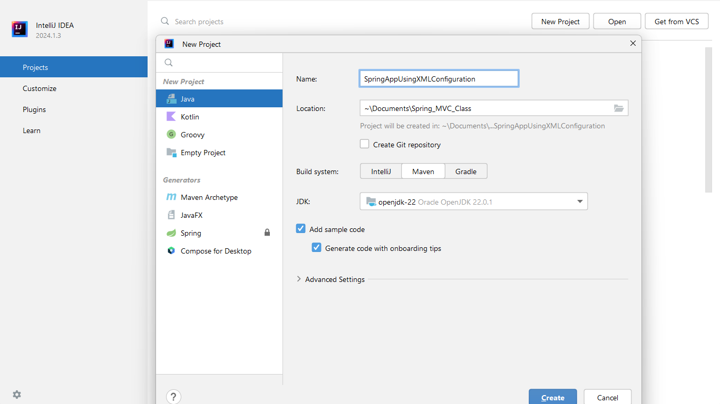

Slide 154
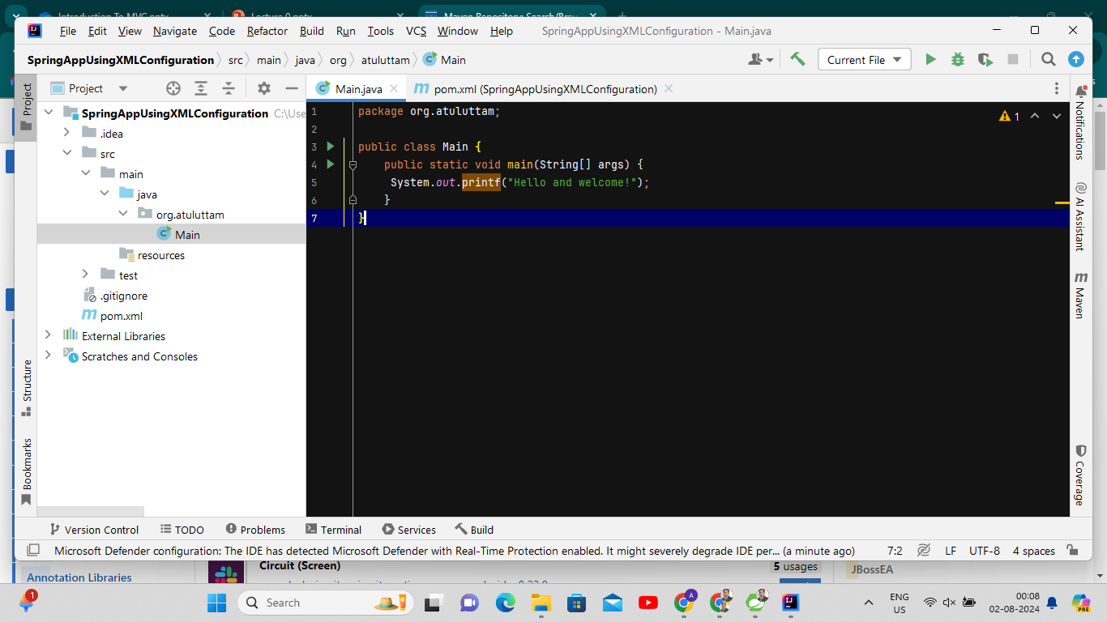

Slide 155
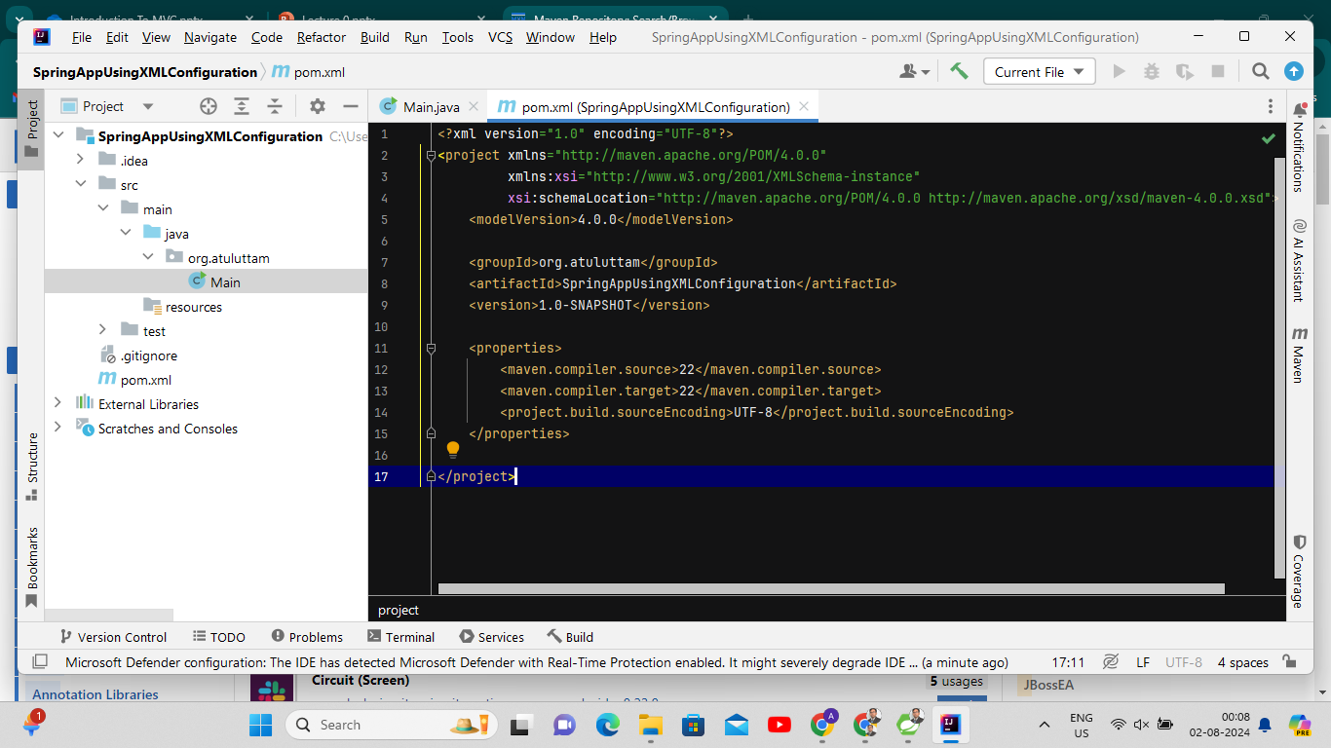

Slide 156
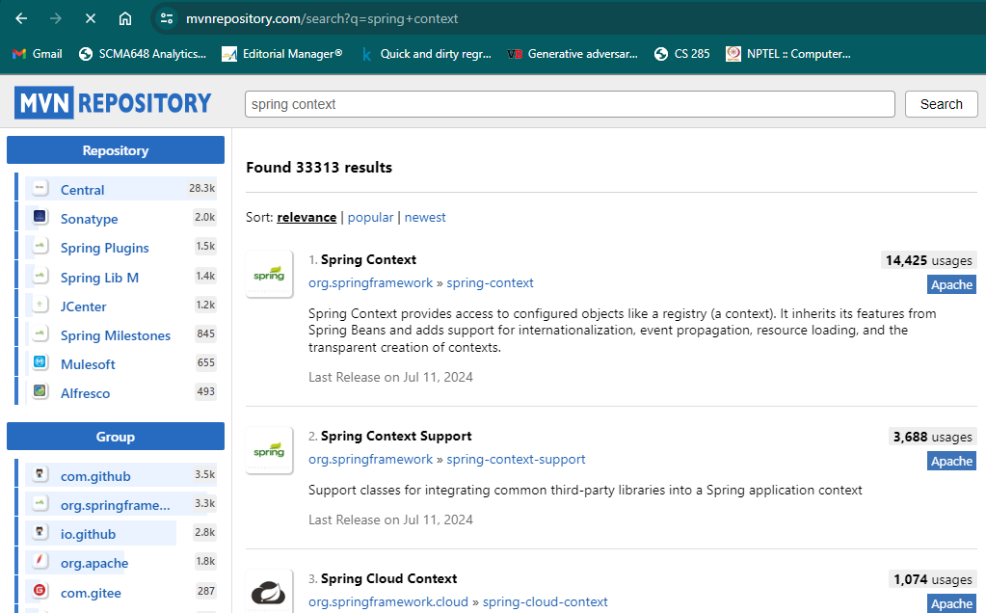

Slide 157
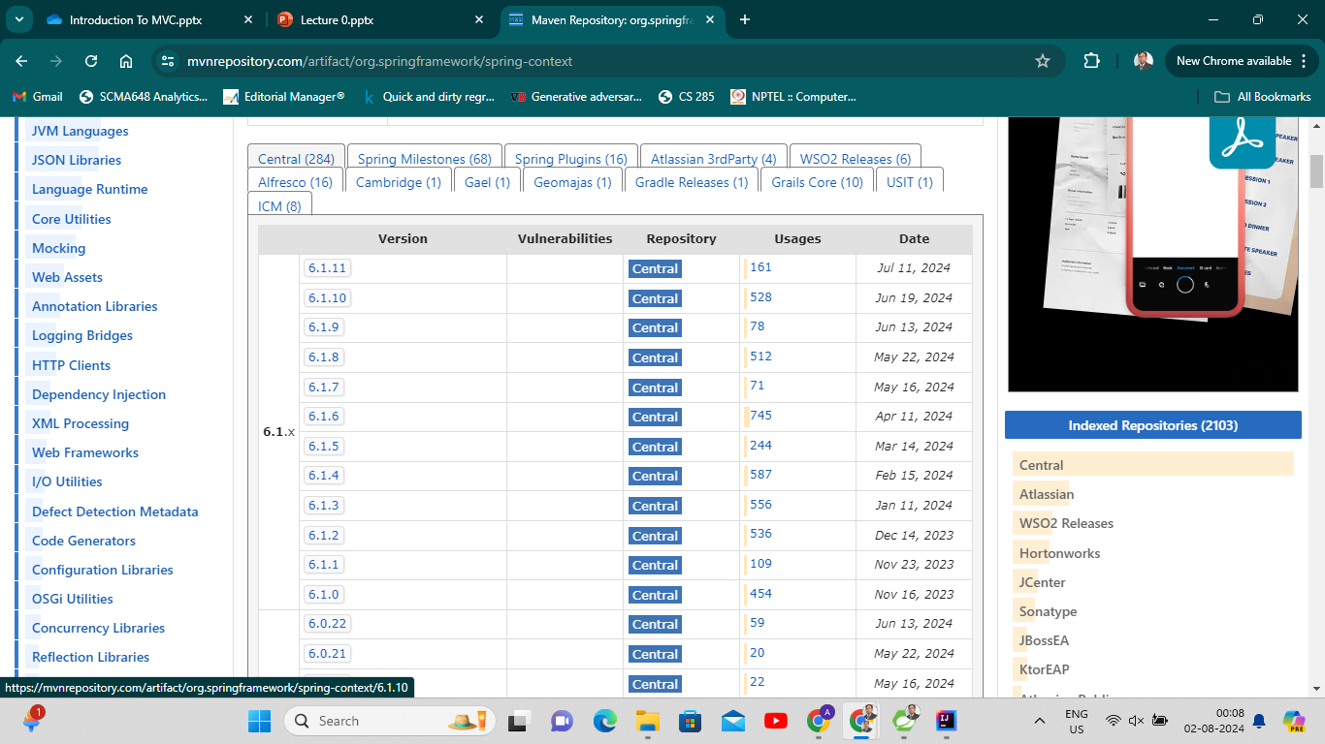

Slide 158
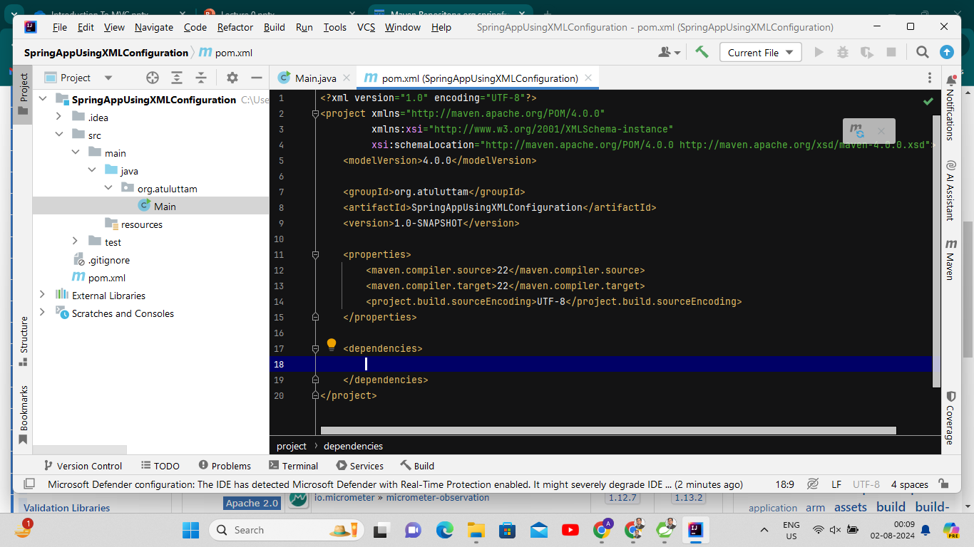

Slide 159


Slide 160


Slide 161


Slide 162


Slide 163


Slide 164


Slide 165


Slide 166


Slide 167


Slide 168


Slide 169


Slide 170


Slide 171

<bean name="student" class = "org.atul.uttam.Student" scope="prototype" />
for getting two different objects OR use different id

Slide 172


Slide 173


Slide 174
Annotation-based Configuration
Define beans using annotation-based configuration metadata on your application’s component classes.
Note: Since Spring Boot has reduced the use of XML configurations, we don’t need to follow this step in Spring Boot Application. We can directly use annotations whenever it is required.

Slide 175
Annotation-based Configuration
Furthermore, in order to make a class as a bean, we need to apply an annotation on the top of the class.
There are various annotations that we can apply on top of the class, such as @Component, @Controller, @Service, @Repository etc.
Most of the time we apply @Component annotation as it is the basic annotation.
@Component
public class Employee{
private Long id;
private String name;
private String department;
}

Slide 176


Slide 177


Slide 178

@Component
//@Scope("singleton") //Default not necessary to write, will //provide one instance
@Scope("prototype") //provide more than one instances as per requirement
public class Laptop
{
@Autowired
private HardDisk HDD;

Slide 179


Slide 180
Java-based Configuration
Starting with Spring 3.0, a pure-Java configuration container was provided.
We don’t need any XML with this method of configuration.
The key features in Spring Framework’s new Java-configuration support are @Configuration
annotated classes and @Bean annotated methods.
Using @Configuration annotation represents that Spring container will use it as a source of Beans definitions.
The @Bean annotation is used to indicate that a method instantiates, configures, and initializes a new object to be managed by the Spring IoC container.
1. @Bean annotation plays the same role as the <bean/> element.
2. @Configuration classes allow define inter-bean dependencies by simply calling other @Bean methods in the same class.

Slide 181
Java-based Configuration
The @Bean annotation is used to indicate that a method instantiates, configures, and initializes a new object to be managed by the Spring IoC container.
@Configuration
public class EmployeeConfig{
@Bean
public EmployeeBean permanentEmployee(){
return new EmployeeBean();
}
@Bean(name="contractEmployee")
public EmployeeBean otherEmployee(){
return new EmployeeBean();
}
}
Here, method name becomes the bean id by default.
However, we can provide the name of bean as per our choice by specifying ‘name’ attribute of @Bean annotation as shown left.

Slide 182


Slide 183


Slide 184


Slide 185


Slide 186


Slide 187


Slide 188
Dependency Injection in Spring
Types of Dependency Injection:
  Constructor,
  Setter,
  Field
Configuring DI:
  XML-based
  Annotation-based (@Autowired)
  Best Practices and Managing Dependencies

Slide 189

Dependency

Slide 190
Introduction to Inversion of Control (IoC)
Inversion of Control (IoC) refers to a programming principle where
The control of object creation and management is transferred from the programmer to a framework.
This shift allows developers to focus more on the business logic rather than the infrastructure.

Slide 191
Dependency Injection (DI) in Spring
In Java, before we can use methods of other classes, we first need to create the object of that class (i.e. class A needs to create an instance of class B).
So, transferring the task of creating the object to someone else and directly using the dependency is called dependency injection.
When class A uses some functionality of class B, then its said that class A has a dependency of class B.
Dependencies can be injected at runtime rather than at compile time

Slide 192
Dependency Injection (DI) in Spring
Dependency Injection (DI) is a design pattern used to implement IoC, where dependencies are injected into objects rather than the objects creating them themselves.
In the context of Spring, IoC is managed through the IoC container, which creates and maintains objects.
DI then ensures that these objects are correctly linked and injected where needed, thereby facilitating a clean separation of concerns and enhancing modularity.

Slide 193


Slide 194


Slide 195


Slide 196


Slide 197


Dependency Injection
HDD interface
SaveData()

Slide 198


Slide 199
package com.atuluttam.DependencyInjectionAnnotation;
import org.springframework.boot.SpringApplication;
import org.springframework.boot.autoconfigure.SpringBootApplication;
import org.springframework.context.ApplicationContext;
@SpringBootApplication
public class DependencyInjectionAnnotationApplication {
public static void main(String[] args) {
ApplicationContext context = SpringApplication.run(DependencyInjectionAnnotationApplication.class, args);
Laptop macbook = context.getBean(Laptop.class);
macbook.writeData();
}
}

Slide 200


Slide 201
package com.atuluttam.DependencyInjectionAnnotation;
public interface HardDisk
{
void saveData();
}

Slide 202


Slide 203
package com.atuluttam.DependencyInjectionAnnotation;
import org.springframework.stereotype.Component;
@Component
public class SanDisk implements HardDisk{
@Override
public void saveData()
{
System.out.println("Your Data is Saved!! in SanDisk");
}
}

Slide 204


Slide 205
package com.atuluttam.DependencyInjectionAnnotation;
import org.springframework.stereotype.Component;
@Component
public class Laptop {
private HardDisk HDD;
public Laptop(HardDisk HDD)
{
this.HDD = HDD;
}
public void writeData()
{
HDD.saveData();
}
}

Slide 206
Let we have two implementation of HDD interface.....???
package com.atuluttam.DependencyInjectionAnnotation;
public interface HardDisk {
void saveData();
}
package com.atuluttam.DependencyInjectionAnnotation;
import org.springframework.stereotype.Component;
@Component
public class SanDisk implements HardDisk{
@Override
public void saveData()
{
System.out.println("Yo
ur Data is Saved!! in SanDisk HDD");
}
}
package com.atuluttam.DependencyInjectionAnnotation;
import org.springframework.stereotype.Component;
@Component
public class Samsung implements HardDisk{
@Override
public void saveData()
{
System.out.println("Your Data is Saved!! in Samsung HDD");
}
}
expected single matching bean but found 2: samsung, sanDisk

Slide 207
To Resolve it........
1. Use @Qualifier Annotation
2. Set a Primary Bean Using @Primary
3. Use Constructor Injection with Explicit Beans

Slide 208
1. Use @Qualifier Annotation
@Qualifier("sanDisk") specifies that the SanDisk implementation should be injected into the Laptop class. The name used in @Qualifier corresponds to the bean name, which by default is the class name with the first letter in lowercase.
package com.atuluttam.DependencyInjectionAnnotation;
@Component
public class Laptop {
private final HardDisk HDD;
@Autowired
public Laptop(@Qualifier("sanDisk") HardDisk HDD) // Use the name of the bean
this.HDD = HDD;
}
public void writeData() {
HDD.saveData();
}
}

Slide 209
2. Set a Primary Bean Using @Primary
@Primary annotation. This tells Spring to inject this bean by default if no other specific bean is specified.
package com.atuluttam.DependencyInjectionAnnotation;
@Component
@Primary
public class SanDisk implements HardDisk {
@Override
public void saveData() {
System.out.println("Your Data is Saved!! in SanDisk");
}
}
But what if both @Qualifier("samsung") and @Primary at Sandisk Class, then which one will be preferred........?????

Slide 210
2. Set a Primary Bean Using @Primary
@Qualifier will be preferred

Slide 211
3. Use Constructor Injection with Explicit Beans
You can also specify the exact bean to be injected by defining the beans explicitly in a configuration class:
@Configuration
public class HardDiskConfig
{
@Bean
public HardDisk sanDisk()
{
return new SanDisk();
}
@Bean
public HardDisk samsung()
{
return new Samsung();
}
}
Explicit Beans: Define beans in a configuration class and inject them explicitly using @Qualifier.
@Bean
@Scope("prototype")
The default scope is singleton, but you can override this with the @Scope annotation

Slide 212
@Component
public class Laptop {
private final HardDisk HDD;
@Autowired
public Laptop(@Qualifier("samsung") HardDisk HDD)
{
this.HDD = HDD;
}
public void writeData() {
HDD.saveData();
}
}
// Use the name of the bean explicitly

Slide 213

Types of dependency injection in spring boot
Dependency injection in Spring can be done through
Constructor injection
Setters injection
Field injection
Now, each approach can be executed in two ways — you can:
use Java annotations like @Autowired and let Spring scan for components in your codebase
define each bean in your spring config XML file.

Slide 214

Injection using Annotations and Autowiring

Slide 215
Autowiring
Spring can automatically find beans by matching the type (class or interface) and inject it automatically.
So, if you want to inject a HardDisk implementation into Laptop, you can annotate the HardDisk attribute of Laptop class with @Autowired.
This will tell spring to scan all the components in your code, find a bean which matches the class of type HardDisk, and inject it into the Laptop.
For eg: If you annotate HitachiHD with @Component, it will inject HitachiHD into Laptop.
Now, there are three ways of autowiring beans:
  Field injection
  Constructor injection
  Setter injection

Slide 216
Field Injection using Annotation
Field injection directly injects dependencies into fields.
Using Java Annotations (@Autowired)
  You annotate the field with @Autowired to inject the dependency.
@Component
public class Laptop
{
@Autowired
private HardDisk hardDisk;
public void saveData()
{
hardDisk.saveData();
}
}
@Component
public class HitachiHD implements HardDisk {
public void saveData()
{
System.out.println("HitachiHD: saveData");
}
}

Slide 217
Constructor Injection using Annotation
@Component
public class Laptop {
private HardDisk hardDisk;
@Autowired
public Laptop(HardDisk hardDisk)
{
this.hardDisk = hardDisk;
}
public void saveData(){
hardDisk.saveData();
}
}
As of Spring Framework 4.3, an @Autowired annotation on such a constructor is no longer necessary if the target bean defines only one constructor to begin with.
However, if several constructors are available and there is no primary/default constructor, at least one of the constructors must be annotated with @Autowired in order to instruct the container which one to use.

Slide 218
Setter Injection using Annotation
Here you annotate the setter method of the relevant attribute with @Autowired.
@Component
public class Laptop
{
private HardDisk hardDisk;
@Autowired
public void setHardDisk(HardDisk hardDisk)
{
this.hardDisk = hardDisk;
}
public void saveData()
{
hardDisk.saveData();
}
}

Slide 219
Dependency Injection with XML configuration
Another way to configure Spring runtime with constructor-based dependency injection is to use an XML configuration file.
In this case, we need to bootstrap our Spring application context using ClassPathXmlApplicationContext.
This approach is not used commonly, and you’ll see it rarely in professional codebases. This is because for large projects, defining each bean in XML configuration file is not practical.

Slide 220
Constructor Injection using XML
For injecting a bean into a class,
You have to define the beans you want to inject into Laptop object using constructor-arg in applicationContext.xml file.
applicationContext.xml is a spring config file from which we can the set different properties for our Spring container.

Slide 221




Slide 222


Slide 223


Slide 224
import org.springframework.context.ApplicationContext;
import org.springframework.context.support.ClassPathXmlApplicationContext;
public class Main {
public static void main(String[] args) {
// Load the Spring context from the XML configuration file
ApplicationContext context = new ClassPathXmlApplicationContext("spring-config.xml");
// Get the Laptop bean from the context
Laptop laptop = (Laptop) context.getBean("laptop");
// Use the Laptop object to save data using the injected Hdd implementation
laptop.saveDataOnHdd("Hello, World!");
}
}

Slide 225
Setters Injection using XML
public class Laptop
{
private Hdd hdd;
private int Price;
// Setter Injection
public void setHdd(Hdd hdd)
{
this.hdd = hdd;
}
// Setter Injection
public void setPrice(int Price)
{
this.Price = Price;
}
public void saveDataOnHdd(String data)
{
hdd.saveData(data);
}
}

Slide 226
<bean id = "sandisk" class = "com.example.Sandisk"/>
<bean id = "hitachi" class = "com.example.Hitachi"/>
<!-- Define the Laptop bean and inject the Hdd dependency using setter injection -->
<bean id="laptop" class="com.example.Laptop">
<property name = "hdd" ref = "sandisk"/>
<property name = "Price" value = "1000" />
</bean>
<!-- If you want to use Hitachi instead, change the property ref to "hitachi" -->
<!-- <bean id="laptop" class="com.example.Laptop">
<property name="hdd" ref="hitachi"/> </bean> -->

Slide 227
import org.springframework.context.ApplicationContext;
import org.springframework.context.support.ClassPathXmlApplicationContext;
public class Main {
public static void main(String[] args) {
// Load the Spring context from the XML configuration file
ApplicationContext context = new ClassPathXmlApplicationContext("spring-config.xml");
// Get the Laptop bean from the context
Laptop laptop = (Laptop) context.getBean("laptop");
// Use the Laptop object to save data using the injected Hdd implementation
laptop.saveDataOnHdd("Hello, World!");
}
}

Slide 228


Slide 229

DI Best Practices and Managing Dependencies in Spring
1. Use Constructor Injection Over Field Injection
Constructor injection is the preferred method for mandatory dependencies as it ensures that a class is always in a valid state after it's constructed. It also makes the code more testable.

Slide 230

Constructor Injection Ensures All Required Dependencies Are Provided at the Time of Object Creation
OrderService cannot be instantiated without a PaymentService.
This ensures that the OrderService always has a PaymentService available when it's created, leading to a more reliable and predictable application behavior

Slide 231

Constructor Injection Facilitates Easier Unit Testing
OrderService is tested in isolation by providing a mock PaymentService.
This way, you can test OrderService without worrying about the actual implementation of PaymentService.

Slide 232
2. Avoid Circular Dependencies
Why: Circular dependencies can lead to runtime errors and make the application difficult to manage.
Spring may not be able to resolve such dependencies, leading to BeanCurrentlyInCreationException.
Solution: Refactor the design to eliminate circular dependencies, possibly by introducing a third class to manage the interaction or by revisiting the design to remove the dependency.

Slide 233
3. Use @Qualifier for Disambiguating Beans
Why: When multiple beans of the same type exist, Spring might not know which one to inject. Using @Qualifier can resolve this ambiguity.
@Autowired
@Qualifier("creditCardPaymentService") private PaymentService paymentService;

Slide 234
4. Use @Primary for Preferred Beans
Why: When multiple beans of the same type are available, you can designate one as the primary bean using @Primary. Spring will prefer this bean over others.
@Bean
@Primary
public PaymentService creditCardPaymentService()
{
return new CreditCardPaymentService();
}

Slide 235
5. Use Scoped Beans Appropriately
Why: Understanding and using the correct bean scope (singleton, prototype, request, session, etc.) is crucial for managing the lifecycle of your beans correctly.
@Scope("prototype")
@Bean
public MyPrototypeBean myPrototypeBean()
{
return new MyPrototypeBean();
}

Slide 236
6. Use @Lazy for Deferred Initialization
Why: By default, Spring initializes all singleton beans at startup.
Using @Lazy defers bean creation until it is actually needed.
Advantages:
Reduces startup time.
Saves resources by creating beans only when necessary.
@Lazy
@Autowired
private MyService myService;

